Slide 1


Lab 9
NN for XOR
With TF 1.0!
Sung Kim <hunkim+ml@gmail.com>
Code: https://github.com/hunkim/DeepLearningZeroToAll/

Slide 2

Call for comments
Please feel free to add comments directly on these slides
Other slides: https://goo.gl/jPtWNt
Picture from http://www.tssablog.org/archives/3280

Slide 3
Lab 9-1
NN for XOR
With TF 1.0!
Sung Kim <hunkim+ml@gmail.com>
Code: https://github.com/hunkim/DeepLearningZeroToAll/

Slide 4

https://github.com/hunkim/DeepLearningZeroToAll/

Slide 5
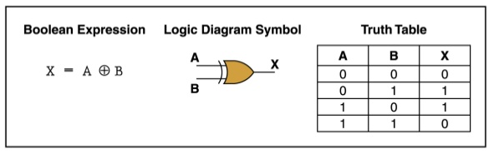
XOR data set
x_data = np.array([[0, 0], [0, 1], [1, 0], [1, 1]], dtype=np.float32)
y_data = np.array([[0], [1], [1], [0]], dtype=np.float32)
http://templ25.mandaringardencity.com/xor-gate-truth-table-2/

Slide 6
XOR with
logistic regression?
But
it doesn’t work
x_data = np.array([[0, 0], [0, 1], [1, 0], [1, 1]], dtype=np.float32)
y_data = np.array([[0], [1], [1], [0]], dtype=np.float32)
X = tf.placeholder(tf.float32)
Y = tf.placeholder(tf.float32)
W = tf.Variable(tf.random_normal([2, 1]), name='weight')
b = tf.Variable(tf.random_normal([1]), name='bias')
# Hypothesis using sigmoid: tf.div(1., 1. + tf.exp(tf.matmul(X, W)))
hypothesis = tf.sigmoid(tf.matmul(X, W) + b)
# cost/loss function
cost = -tf.reduce_mean(Y * tf.log(hypothesis) + (1 - Y) * tf.log(1 - hypothesis))
train = tf.train.GradientDescentOptimizer(learning_rate=0.1).minimize(cost)
# Accuracy computation
# True if hypothesis>0.5 else False
predicted = tf.cast(hypothesis > 0.5, dtype=tf.float32)
accuracy = tf.reduce_mean(tf.cast(tf.equal(predicted, Y), dtype=tf.float32))
# Launch graph
with tf.Session() as sess:
# Initialize TensorFlow variables
sess.run(tf.global_variables_initializer())
for step in range(10001):
sess.run(train, feed_dict={X: x_data, Y: y_data})
if step % 100 == 0:
print(step, sess.run(cost, feed_dict={X: x_data, Y: y_data}), sess.run(W))
# Accuracy report
h, c, a = sess.run([hypothesis, predicted, accuracy], feed_dict={X: x_data, Y: y_data})
print("\nHypothesis: ", h, "\nCorrect: ", c, "\nAccuracy: ", a)
https://github.com/hunkim/DeepLearningZeroToAll/blob/master/lab-09-1-xor.py

Slide 7
XOR with
logistic regression?
But
it doesn’t work!
x_data = np.array([[0, 0], [0, 1], [1, 0], [1, 1]], dtype=np.float32)
y_data = np.array([[0], [1], [1], [0]], dtype=np.float32)
X = tf.placeholder(tf.float32)
Y = tf.placeholder(tf.float32)
W = tf.Variable(tf.random_normal([2, 1]), name='weight')
b = tf.Variable(tf.random_normal([1]), name='bias')
# Hypothesis using sigmoid: tf.div(1., 1. + tf.exp(tf.matmul(X, W)))
hypothesis = tf.sigmoid(tf.matmul(X, W) + b)
# cost/loss function
cost = -tf.reduce_mean(Y * tf.log(hypothesis) + (1 - Y) * tf.log(1 - hypothesis))
train = tf.train.GradientDescentOptimizer(learning_rate=0.1).minimize(cost)
# Accuracy computation
# True if hypothesis>0.5 else False
predicted = tf.cast(hypothesis > 0.5, dtype=tf.float32)
accuracy = tf.reduce_mean(tf.cast(tf.equal(predicted, Y), dtype=tf.float32))
# Launch graph
with tf.Session() as sess:
# Initialize TensorFlow variables
sess.run(tf.global_variables_initializer())
for step in range(10001):
sess.run(train, feed_dict={X: x_data, Y: y_data})
if step % 100 == 0:
print(step, sess.run(cost, feed_dict={X: x_data, Y: y_data}), sess.run(W))
# Accuracy report
h, c, a = sess.run([hypothesis, predicted, accuracy], feed_dict={X: x_data, Y: y_data})
print("\nHypothesis: ", h, "\nCorrect: ", c, "\nAccuracy: ", a)
Hypothesis:
[[ 0.5]
[ 0.5]
[ 0.5]
[ 0.5]]
Correct:
[[ 0.]
[ 0.]
[ 0.]
[ 0.]]
Accuracy: 0.5
https://github.com/hunkim/DeepLearningZeroToAll/blob/master/lab-09-1-xor.py

Slide 8
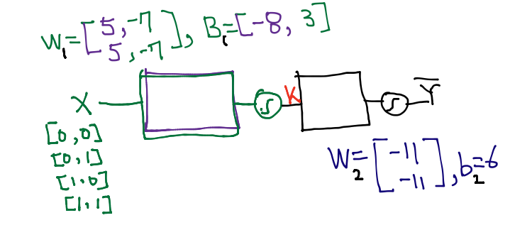
Neural Net
W = tf.Variable(tf.random_normal([2, 1]), name='weight')
b = tf.Variable(tf.random_normal([1]), name='bias')
# Hypothesis using sigmoid: tf.div(1., 1. + tf.exp(tf.matmul(X, W)))
hypothesis = tf.sigmoid(tf.matmul(X, W) + b)
https://github.com/hunkim/DeepLearningZeroToAll/blob/master/lab-09-1-xor.py

Slide 9
Neural Net
W = tf.Variable(tf.random_normal([2, 1]), name='weight')
b = tf.Variable(tf.random_normal([1]), name='bias')
# Hypothesis using sigmoid: tf.div(1., 1. + tf.exp(tf.matmul(X, W)))
hypothesis = tf.sigmoid(tf.matmul(X, W) + b)
W1 = tf.Variable(tf.random_normal([2, 2]), name='weight1')
b1 = tf.Variable(tf.random_normal([2]), name='bias1')
layer1 = tf.sigmoid(tf.matmul(X, W1) + b1)
W2 = tf.Variable(tf.random_normal([2, 1]), name='weight2')
b2 = tf.Variable(tf.random_normal([1]), name='bias2')
hypothesis = tf.sigmoid(tf.matmul(layer1, W2) + b2)
https://github.com/hunkim/DeepLearningZeroToAll/blob/master/lab-09-2-xor-nn.py

Slide 10
NN for XOR
x_data = np.array([[0, 0], [0, 1], [1, 0], [1, 1]], dtype=np.float32)
y_data = np.array([[0], [1], [1], [0]], dtype=np.float32)
X = tf.placeholder(tf.float32)
Y = tf.placeholder(tf.float32)
W1 = tf.Variable(tf.random_normal([2, 2]), name='weight1')
b1 = tf.Variable(tf.random_normal([2]), name='bias1')
layer1 = tf.sigmoid(tf.matmul(X, W1) + b1)
W2 = tf.Variable(tf.random_normal([2, 1]), name='weight2')
b2 = tf.Variable(tf.random_normal([1]), name='bias2')
hypothesis = tf.sigmoid(tf.matmul(layer1, W2) + b2)
# cost/loss function
cost = -tf.reduce_mean(Y * tf.log(hypothesis) + (1 - Y) * tf.log(1 - hypothesis))
train = tf.train.GradientDescentOptimizer(learning_rate=0.1).minimize(cost)
# Accuracy computation
# True if hypothesis>0.5 else False
predicted = tf.cast(hypothesis > 0.5, dtype=tf.float32)
accuracy = tf.reduce_mean(tf.cast(tf.equal(predicted, Y), dtype=tf.float32))
# Launch graph
with tf.Session() as sess:
# Initialize TensorFlow variables
sess.run(tf.global_variables_initializer())
for step in range(10001):
sess.run(train, feed_dict={X: x_data, Y: y_data})
if step % 100 == 0:
print(step, sess.run(cost, feed_dict={X: x_data, Y: y_data}), sess.run([W1, W2]))
# Accuracy report
h, c, a = sess.run([hypothesis, predicted, accuracy],
feed_dict={X: x_data, Y: y_data})
print("\nHypothesis: ", h, "\nCorrect: ", c, "\nAccuracy: ", a)
Hypothesis:
[[ 0.01338218]
[ 0.98166394]
[ 0.98809403]
[ 0.01135799]]
Correct:
[[ 0.]
[ 1.]
[ 1.]
[ 0.]]
Accuracy: 1.0
https://github.com/hunkim/DeepLearningZeroToAll/blob/master/lab-09-2-xor-nn.py

Slide 11
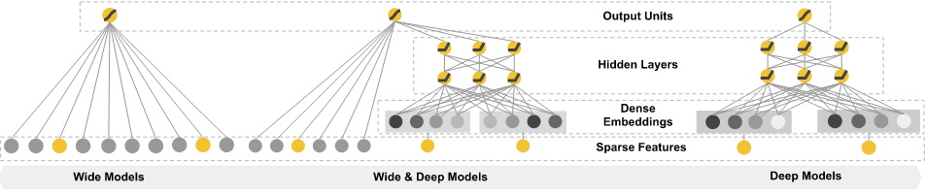
Wide NN for XOR
W1 = tf.Variable(tf.random_normal([2, 10]), name='weight1')
b1 = tf.Variable(tf.random_normal([10]), name='bias1')
layer1 = tf.sigmoid(tf.matmul(X, W1) + b1)
W2 = tf.Variable(tf.random_normal([10, 1]), name='weight2')
b2 = tf.Variable(tf.random_normal([1]), name='bias2')
hypothesis = tf.sigmoid(tf.matmul(layer1, W2) + b2)
[2,10], [10,1]
Hypothesis:
[[ 0.00358802]
[ 0.99366933]
[ 0.99204296]
[ 0.0095663 ]]
Correct:
[[ 0.]
[ 1.]
[ 1.]
[ 0.]]
Accuracy: 1.0
[2,2], [2,1]
Hypothesis:
[[ 0.01338218]
[ 0.98166394]
[ 0.98809403]
[ 0.01135799]]
Correct:
[[ 0.]
[ 1.]
[ 1.]
[ 0.]]
Accuracy: 1.0
https://github.com/hunkim/DeepLearningZeroToAll/blob/master/lab-09-3-xor-nn-wide-deep.py

Slide 12
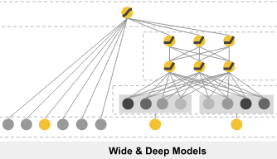
Deep NN for XOR
W1 = tf.Variable(tf.random_normal([2, 10]), name='weight1')
b1 = tf.Variable(tf.random_normal([10]), name='bias1')
layer1 = tf.sigmoid(tf.matmul(X, W1) + b1)
W2 = tf.Variable(tf.random_normal([10, 10]), name='weight2')
b2 = tf.Variable(tf.random_normal([10]), name='bias2')
layer2 = tf.sigmoid(tf.matmul(layer1, W2) + b2)
W3 = tf.Variable(tf.random_normal([10, 10]), name='weight3')
b3 = tf.Variable(tf.random_normal([10]), name='bias3')
layer3 = tf.sigmoid(tf.matmul(layer2, W3) + b3)
W4 = tf.Variable(tf.random_normal([10, 1]), name='weight4')
b4 = tf.Variable(tf.random_normal([1]), name='bias4')
hypothesis = tf.sigmoid(tf.matmul(layer3, W4) + b4)
4 layers
Hypothesis:
[[ 7.80e-04]
[ 9.99e-01]
[ 9.98e-01]
[ 1.55e-03]]
Correct:
[[ 0.]
[ 1.]
[ 1.]
[ 0.]]
Accuracy: 1.0
2 layers
Hypothesis:
[[ 0.01338218]
[ 0.98166394]
[ 0.98809403]
[ 0.01135799]]
Correct:
[[ 0.]
[ 1.]
[ 1.]
[ 0.]]
Accuracy: 1.0
https://github.com/hunkim/DeepLearningZeroToAll/blob/master/lab-09-3-xor-nn-wide-deep.py

Slide 13
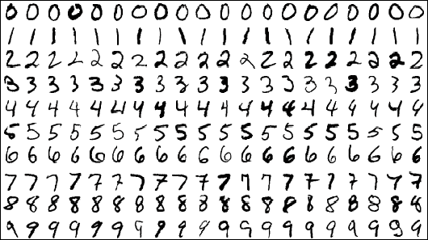
Exercise
Wide and Deep NN for MNIST

Slide 14
Lab 9-2
Tensorboard for XOR NN
With TF 1.0!
Sung Kim <hunkim+ml@gmail.com>
Code: https://github.com/hunkim/DeepLearningZeroToAll/

Slide 15
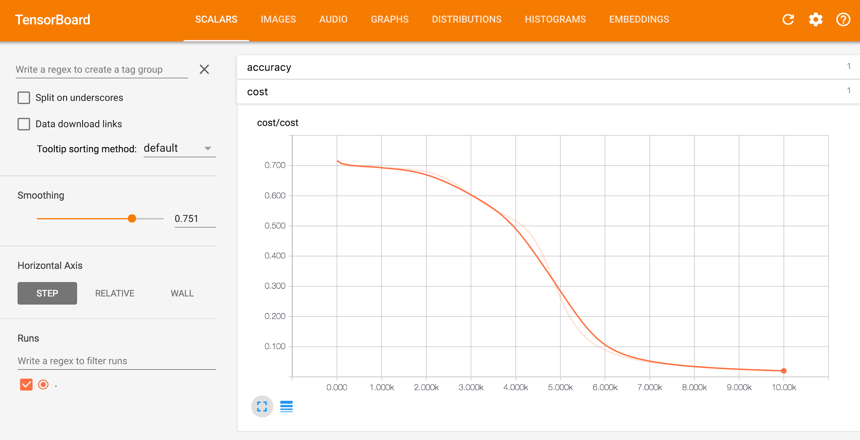
TensorBoard: TF logging/debugging tool
Visualize your TF graph
Plot quantitative metrics
Show additional data
https://www.tensorflow.org/get_started/summaries_and_tensorboard

Slide 16
Old fashion: print, print, print
9400 0.0151413 [array([[ 6.21692038, 6.05913448],
[-6.33773184, -5.75189114]], dtype=float32), array([[ 9.93581772],
[-9.43034935]], dtype=float32)]
9500 0.014909 [array([[ 6.22498751, 6.07049847],
[-6.34637976, -5.76352596]], dtype=float32), array([[ 9.96414757],
[-9.45942593]], dtype=float32)]
9600 0.0146836 [array([[ 6.23292685, 6.08166742],
[-6.35489035, -5.77496052]], dtype=float32), array([[ 9.99207973],
[-9.48807526]], dtype=float32)]
9700 0.0144647 [array([[ 6.24074268, 6.09264851],
[-6.36326933, -5.78619957]], dtype=float32), array([[ 10.01962471],
[ -9.51631165]], dtype=float32)]
9800 0.0142521 [array([[ 6.24843407, 6.10344648],
[-6.37151814, -5.79724932]], dtype=float32), array([[ 10.04679298],
[ -9.54414845]], dtype=float32)]
9900 0.0140456 [array([[ 6.25601053, 6.11406422],
[-6.3796401 , -5.80811596]], dtype=float32), array([[ 10.07359505],
[ -9.57159519]], dtype=float32)]
10000 0.0138448 [array([[ 6.26347113, 6.12451124],
[-6.38764334, -5.81880617]], dtype=float32), array([[ 10.10004139],
[ -9.59866238]], dtype=float32)]

Slide 17
New way!

Slide 18





5 steps of using TensorBoard
From TF graph, decide which tensors you want to log
w2_hist = tf.summary.histogram("weights2", W2)
cost_summ = tf.summary.scalar("cost", cost)
Merge all summaries
summary = tf.summary.merge_all()
Create writer and add graph
# Create summary writer
writer = tf.summary.FileWriter(‘./logs’)
writer.add_graph(sess.graph)
Run summary merge and add_summary
s, _ = sess.run([summary, optimizer], feed_dict=feed_dict)
writer.add_summary(s, global_step=global_step)
Launch TensorBoard
tensorboard --logdir=./logs

Slide 19
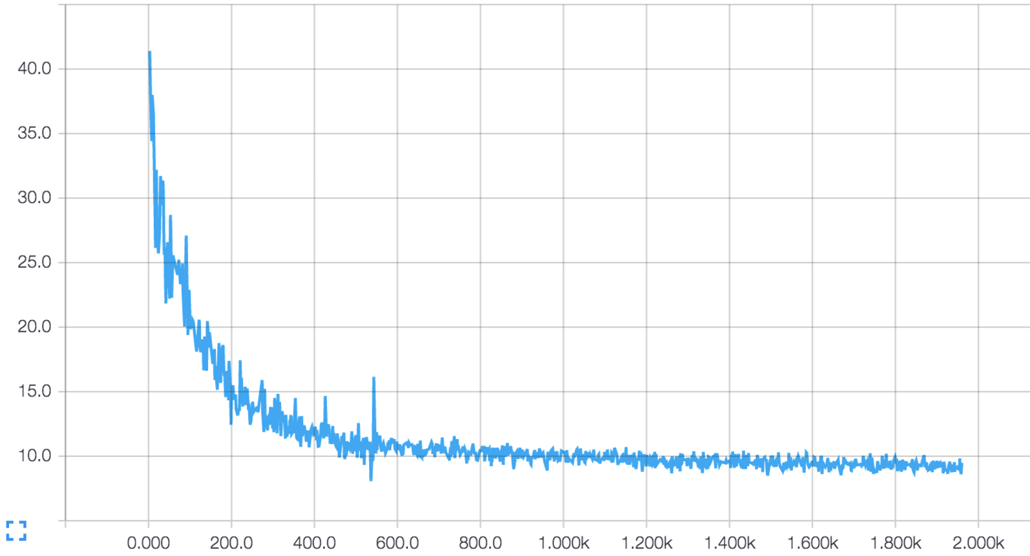
Scalar tensors
cost_summ = tf.summary.scalar("cost", cost)

Slide 20
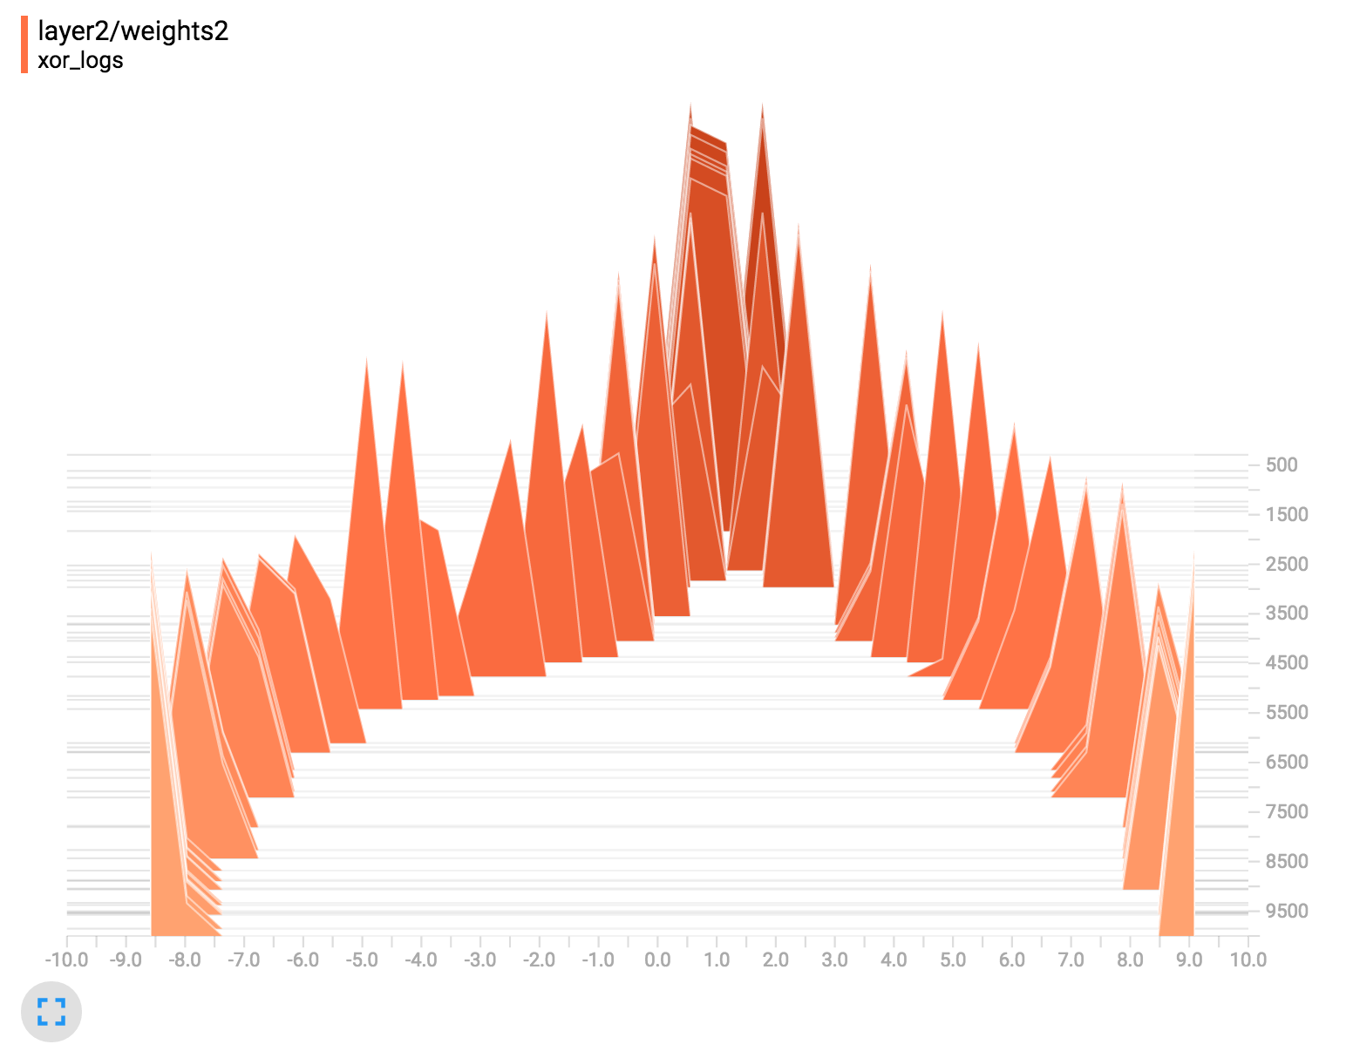
Histogram (multi-dimensional tensors)
W2 = tf.Variable(tf.random_normal([2, 1]), name='weight2')
b2 = tf.Variable(tf.random_normal([1]), name='bias2')
hypothesis = tf.sigmoid(tf.matmul(layer1, W2) + b2)
w2_hist = tf.summary.histogram("weights2", W2)
b2_hist = tf.summary.histogram("biases2", b2)
hypothesis_hist = tf.summary.histogram("hypothesis", hypothesis)
https://github.com/hunkim/DeepLearningZeroToAll/blob/master/lab-09-4-xor_tensorboard.py

Slide 21
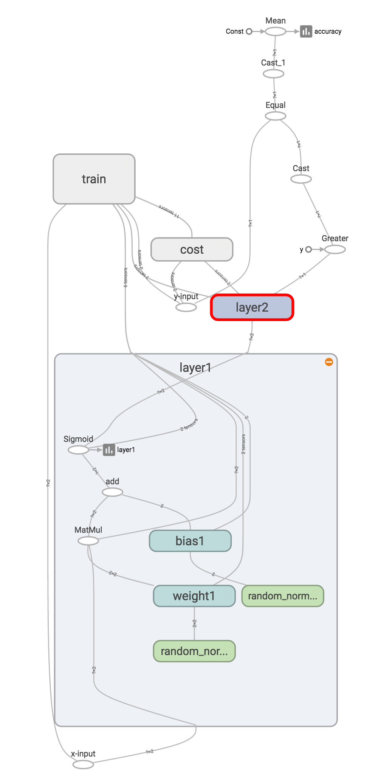
Add scope for better
graph hierarchy
with tf.name_scope("layer1") as scope:
W1 = tf.Variable(tf.random_normal([2, 2]), name='weight1')
b1 = tf.Variable(tf.random_normal([2]), name='bias1')
layer1 = tf.sigmoid(tf.matmul(X, W1) + b1)
w1_hist = tf.summary.histogram("weights1", W1)
b1_hist = tf.summary.histogram("biases1", b1)
layer1_hist = tf.summary.histogram("layer1", layer1)
with tf.name_scope("layer2") as scope:
W2 = tf.Variable(tf.random_normal([2, 1]), name='weight2')
b2 = tf.Variable(tf.random_normal([1]), name='bias2')
hypothesis = tf.sigmoid(tf.matmul(layer1, W2) + b2)
w2_hist = tf.summary.histogram("weights2", W2)
b2_hist = tf.summary.histogram("biases2", b2)
hypothesis_hist = tf.summary.histogram("hypothesis", hypothesis)
https://github.com/hunkim/DeepLearningZeroToAll/blob/master/lab-09-4-xor_tensorboard.py

Slide 22
Merge summaries and create writer
after creating session
# Summary
summary = tf.summary.merge_all()
# initialize
sess = tf.Session()
sess.run(tf.global_variables_initializer())
# Create summary writer
writer = tf.summary.FileWriter(TB_SUMMARY_DIR)
writer.add_graph(sess.graph) # Add graph in the tensorboard
https://github.com/hunkim/DeepLearningZeroToAll/blob/master/lab-09-4-xor_tensorboard.py

Slide 23
Run merged summary and write (add summary)
s, _ = sess.run([summary, optimizer], feed_dict=feed_dict)
writer.add_summary(s, global_step=global_step)
global_step += 1
https://github.com/hunkim/DeepLearningZeroToAll/blob/master/lab-09-4-xor_tensorboard.py

Slide 24
Launch tensorboard (local)
writer = tf.summary.FileWriter("./logs/xor_logs")
$ tensorboard —logdir=./logs/xor_logs
Starting TensorBoard b'41' on port 6006
(You can navigate to http://127.0.0.1:6006)

Slide 25
Launch tensorboard (remote server)
ssh -L local_port:127.0.0.1:remote_port username@server.com
local> $ ssh -L 7007:121.0.0.0:6006 hunkim@server.com
server> $ tensorboard —logdir=./logs/xor_logs
(You can navigate to http://127.0.0.1:7007)

Slide 26
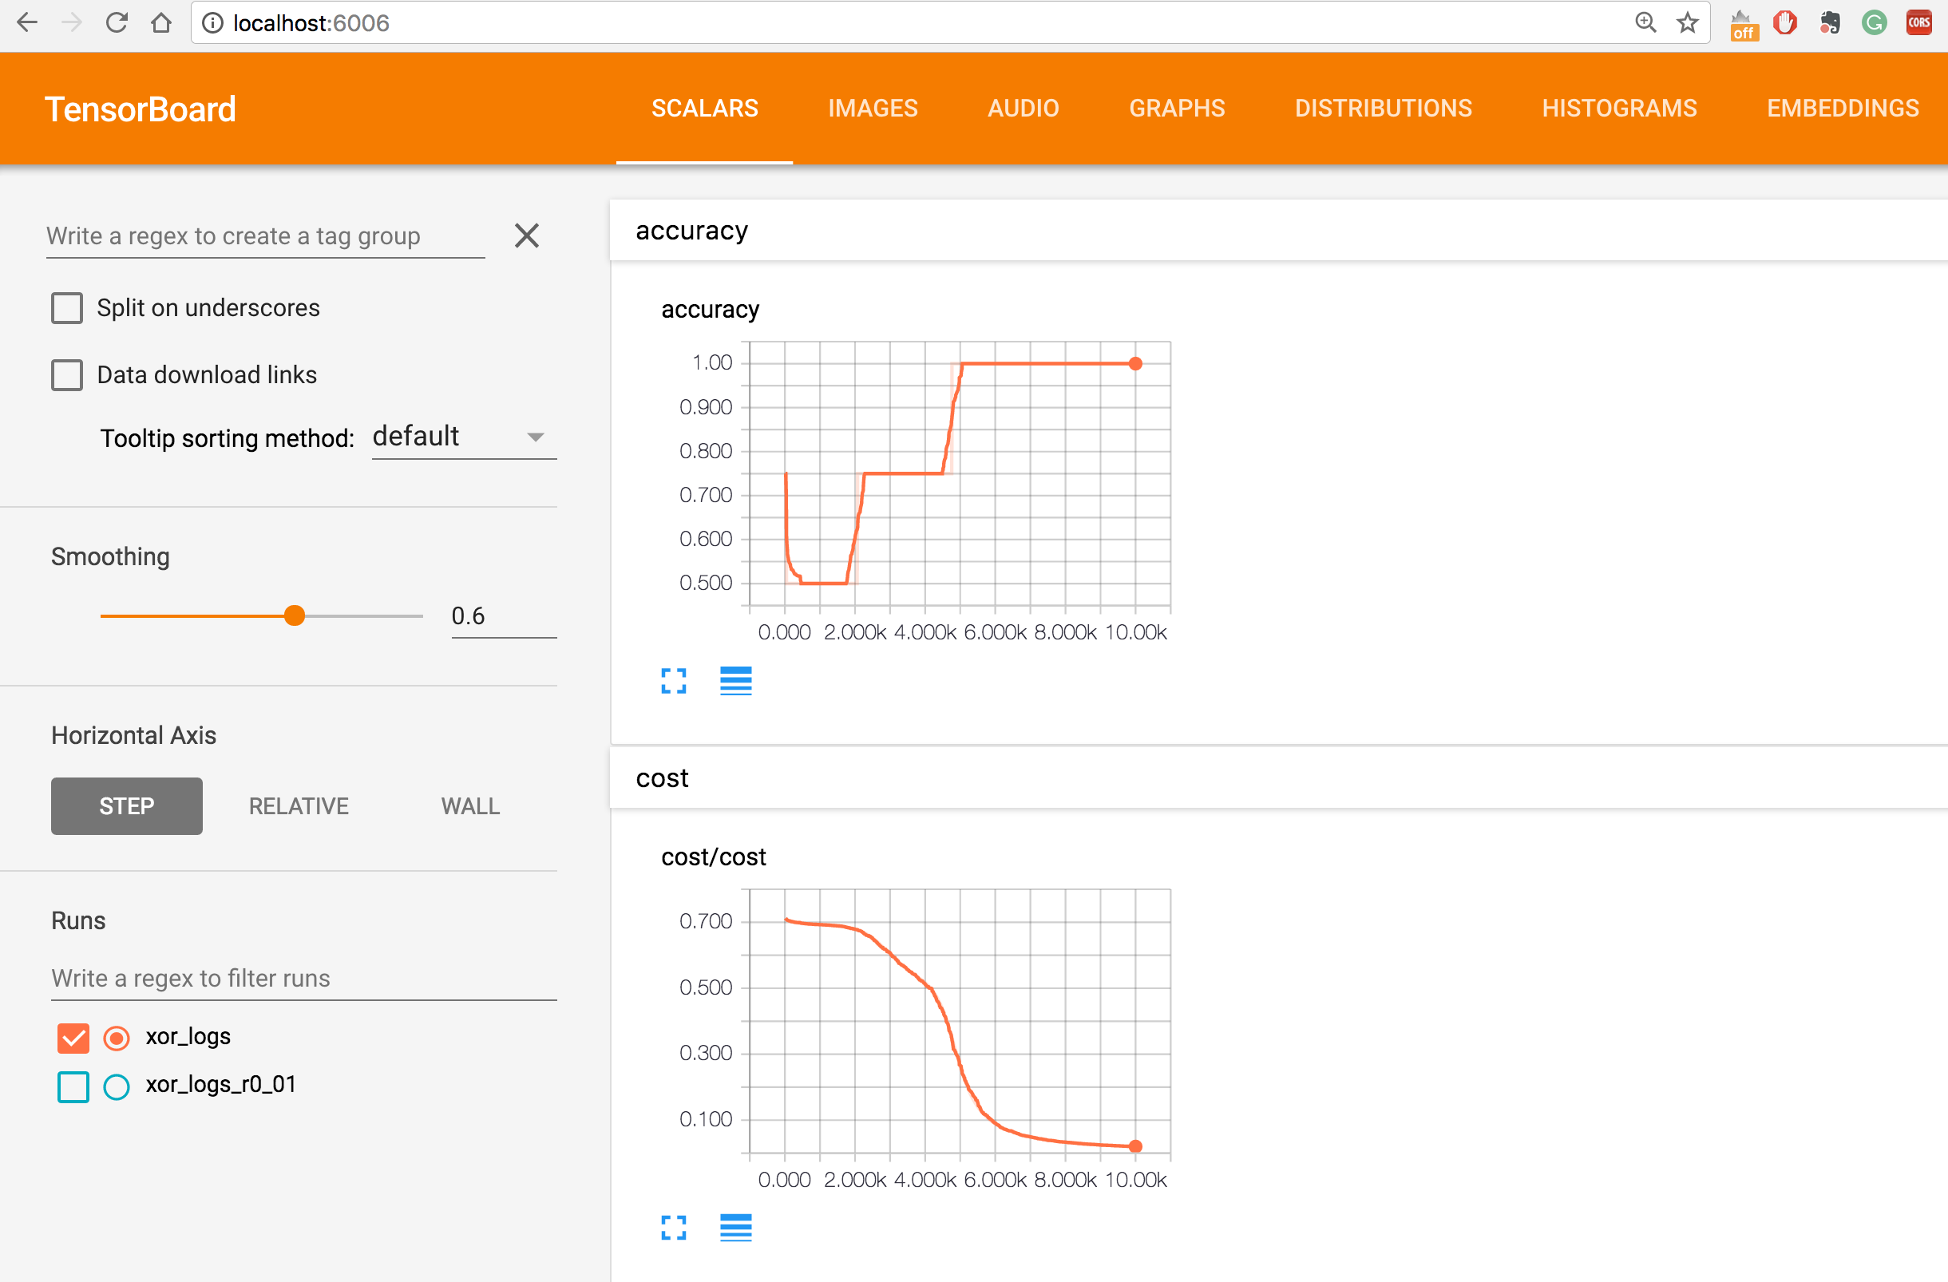

Slide 27
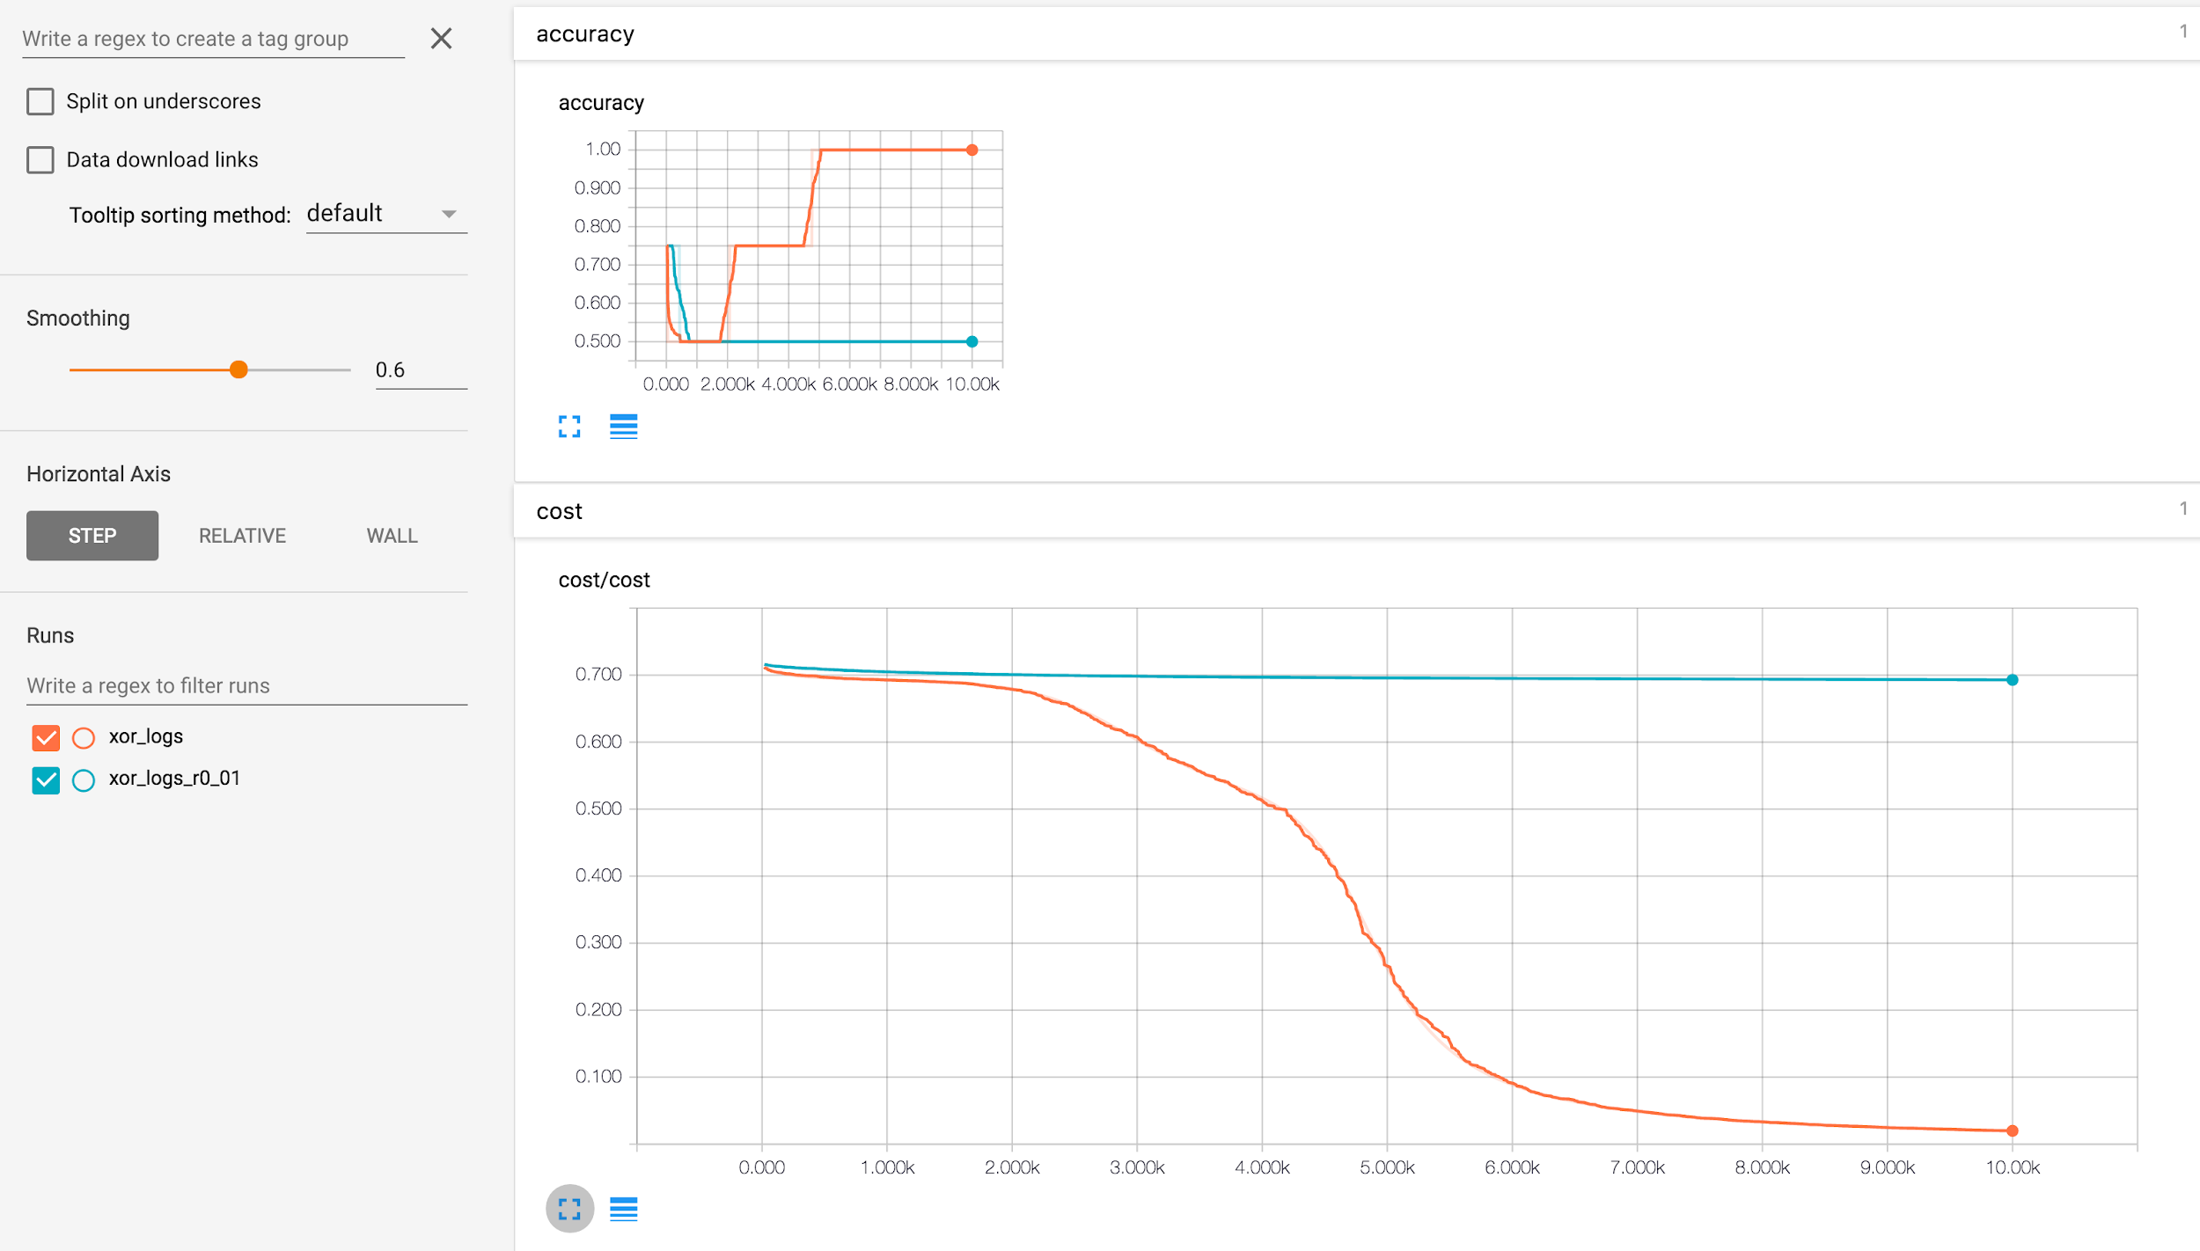
Multiple runs
learning_rate=0.1 VS learning_rate=0.01

Slide 28
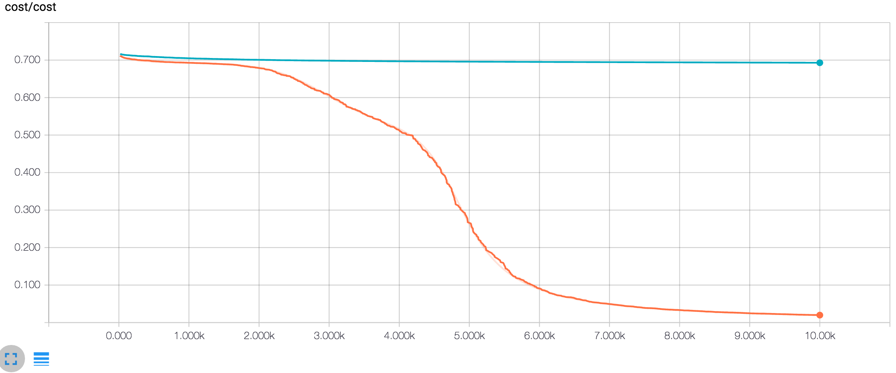
Multiple runs
tensorboard —logdir=./logs/xor_logs
train = tf.train.GradientDescentOptimizer(learning_rate=0.1).minimize(cost)
...
writer = tf.summary.FileWriter("./logs/xor_logs")
tensorboard —logdir=./logs/xor_logs_r0_01
train = tf.train.GradientDescentOptimizer(learning_rate=0.01).minimize(cost)
...
writer = tf.summary.FileWriter(“"./logs/xor_logs_r0_01"”)
tensorboard —logdir=./logs

Slide 29
Multiple runs

Slide 30
5 steps of using TensorBoard
From TF graph, decide which tensors you want to log
w2_hist = tf.summary.histogram("weights2", W2)
cost_summ = tf.summary.scalar("cost", cost)
Merge all summaries
summary = tf.summary.merge_all()
Create writer and add graph
# Create summary writer
writer = tf.summary.FileWriter(‘./logs’)
writer.add_graph(sess.graph)
Run summary merge and add_summary
s, _ = sess.run([summary, optimizer], feed_dict=feed_dict)
writer.add_summary(s, global_step=global_step)
Launch TensorBoard
tensorboard --logdir=./logs

Slide 31
Exercise
Wide and Deep NN for MNIST
Add tensorboard

Slide 32
Lab 9-2-E
Tensorboard for MNIST
With TF 1.0!
Sung Kim <hunkim+ml@gmail.com>
Code: https://github.com/hunkim/DeepLearningZeroToAll/

Slide 33
Visualizing your Deep learning using TensorBoard (TensorFlow)
Sung Kim <hunkim+ml@gmail.com>

Slide 34
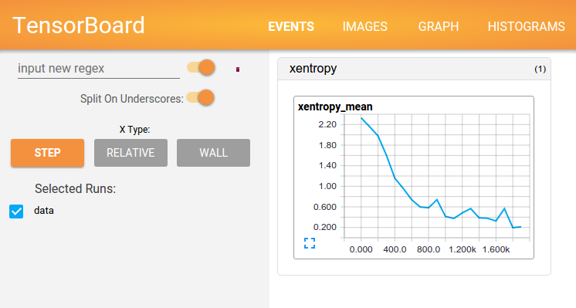
TensorBoard: TF logging/debugging tool
Visualize your TF graph
Plot quantitative metrics
Show additional data
https://www.tensorflow.org/get_started/summaries_and_tensorboard

Slide 35
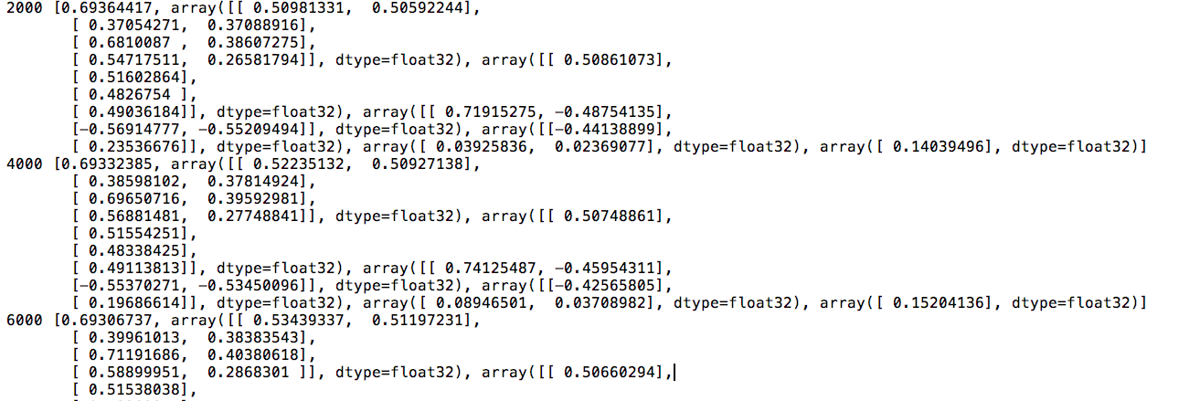
Old fashion: print, print, print

Slide 36
New way!

Slide 37
5 steps of using TensorBoard
From TF graph, decide which tensors you want to log
with tf.variable_scope('layer1') as scope:
tf.summary.image('input', x_image, 3)
tf.summary.histogram("layer", L1)
tf.summary.scalar("loss", cost)
Merge all summaries
summary = tf.summary.merge_all()
Create writer and add graph
# Create summary writer
writer = tf.summary.FileWriter(TB_SUMMARY_DIR)
writer.add_graph(sess.graph)
Run summary merge and add_summary
s, _ = sess.run([summary, optimizer], feed_dict=feed_dict)
writer.add_summary(s, global_step=global_step)
Launch TensorBoard
tensorboard --logdir=/tmp/mnist_logs

Slide 38
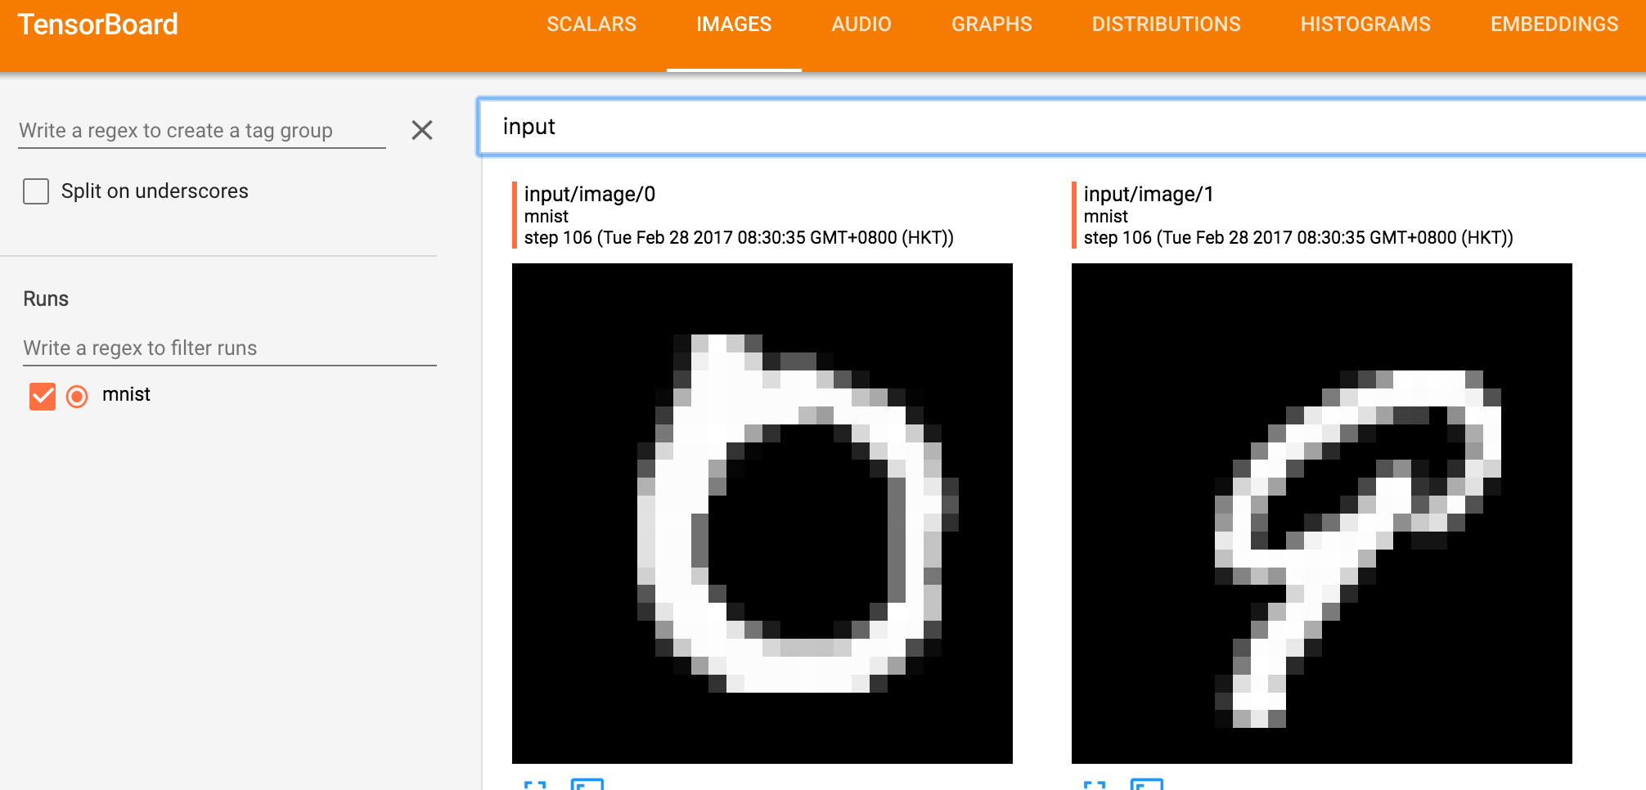
Image Input
# Image input
x_image = tf.reshape(X, [-1, 28, 28, 1])
tf.summary.image('input', x_image, 3)

Slide 39
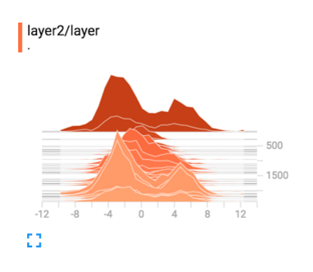
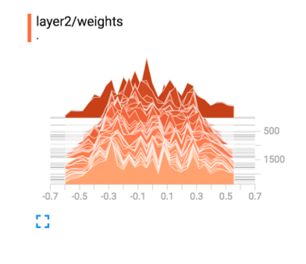
Histogram (multi-dimensional tensors)
with tf.variable_scope('layer1') as scope:
W1 = tf.get_variable("W", shape=[784, 512])
b1 = tf.Variable(tf.random_normal([512]))
L1 = tf.nn.relu(tf.matmul(X, W1) + b1)
L1 = tf.nn.dropout(L1, keep_prob=keep_prob)
tf.summary.histogram("X", X)
tf.summary.histogram("weights", W1)
tf.summary.histogram("bias", b1)
tf.summary.histogram("layer", L1)

Slide 40
Scalar tensors
tf.summary.scalar("loss", cost)

Slide 41
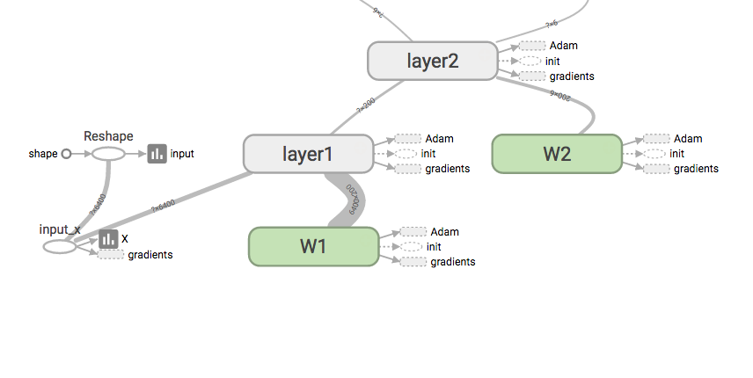
Add scope for better hierarchy
with tf.variable_scope('layer1') as scope:
W1 = tf.get_variable("W", shape=[784, 512],...
b1 = tf.Variable(tf.random_normal([512]))
L1 = tf.nn.relu(tf.matmul(X, W1) + b1)
L1 = tf.nn.dropout(L1, keep_prob=keep_prob)
tf.summary.histogram("X", X)
tf.summary.histogram("weights", W1)
tf.summary.histogram("bias", b1)
tf.summary.histogram("layer", L1)
with tf.variable_scope('layer2') as scope:
...
with tf.variable_scope('layer3') as scope:
...
with tf.variable_scope('layer4') as scope:
...
with tf.variable_scope('layer5') as scope:
...

Slide 42
Merge summaries and create writer
after creating session
# Summary
summary = tf.summary.merge_all()
# initialize
sess = tf.Session()
sess.run(tf.global_variables_initializer())
# Create summary writer
writer = tf.summary.FileWriter(TB_SUMMARY_DIR)
writer.add_graph(sess.graph)

Slide 43
Run merged summary and write (add summary)
s, _ = sess.run([summary, optimizer], feed_dict=feed_dict)
writer.add_summary(s, global_step=global_step)
global_step += 1

Slide 44
Launch tensorboard (local)
writer = tf.summary.FileWriter(“/tmp/mnist_logs”)
$ tensorboard —logdir=/tmp/mnist_logs
Starting TensorBoard b'41' on port 6006
(You can navigate to http://127.0.0.1:6006)

Slide 45
Launch tensorboard (remote server)
ssh -L local_port:127.0.0.1:remote_port username@server.com
local> $ ssh -L 7007:127.0.0.1:6006 hunkim@server.com
server> $ tensorboard —logdir=/tmp/mnist_logs
(You can navigate to http://127.0.0.1:7007)

Slide 46
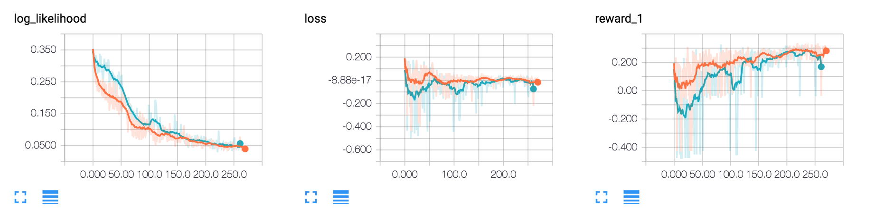
Multiple runs
tensorboard —logdir=/tmp/mnist_logs/run1
writer = tf.summary.FileWriter(“/tmp/mnist_logs/run1”)
tensorboard —logdir=/tmp/mnist_logs/run2
writer = tf.summary.FileWriter(“/tmp/mnist_logs/run1”)
tensorboard —logdir=/tmp/mnist_logs

Slide 47
5 steps of using TensorBoard
From TF graph, decide which tensors you want to log
with tf.variable_scope('layer1') as scope:
tf.summary.image('input', x_image, 3)
tf.summary.histogram("layer", L1)
tf.summary.scalar("loss", cost)
Merge all summaries
summary = tf.summary.merge_all()
Create writer and add graph
# Create summary writer
writer = tf.summary.FileWriter(TB_SUMMARY_DIR)
writer.add_graph(sess.graph)
Run summary merge and add_summary
s, _ = sess.run([summary, optimizer], feed_dict=feed_dict)
writer.add_summary(s, global_step=global_step)
Launch TensorBoard
tensorboard --logdir=/tmp/mnist_logs

Slide 48
Lab 9-3 (optional)
NN Backpropagation
With TF 1.0!
Sung Kim <hunkim+ml@gmail.com>
Code: https://github.com/hunkim/DeepLearningZeroToAll/

Slide 49


https://github.com/hunkim/DeepLearningZeroToAll/

Slide 50
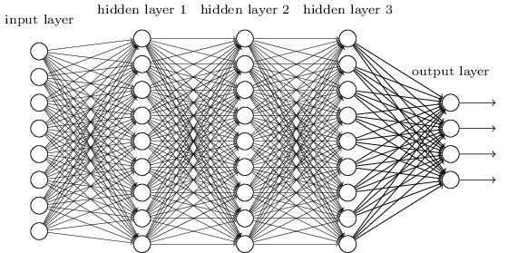
How to train?

Slide 51
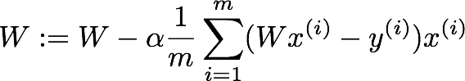
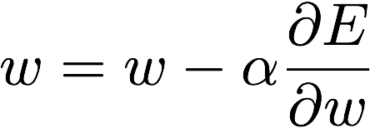
Gradient descent algorithm

Slide 52

Tensorflow
train = tf.train.GradientDescentOptimizer(learning_rate=0.1).minimize(cost)

Slide 53
“Yes you should understand backprop”
“If you try to ignore how it works under the hood because TensorFlow automagically makes my networks learn”
“You will not be ready to wrestle with the dangers it presents”
“You will be much less effective at building and debugging neural networks.”
“The good news is that backpropagation is not that difficult to understand”
“if presented properly.”
https://medium.com/@karpathy/yes-you-should-understand-backprop-e2f06eab496b

Slide 54
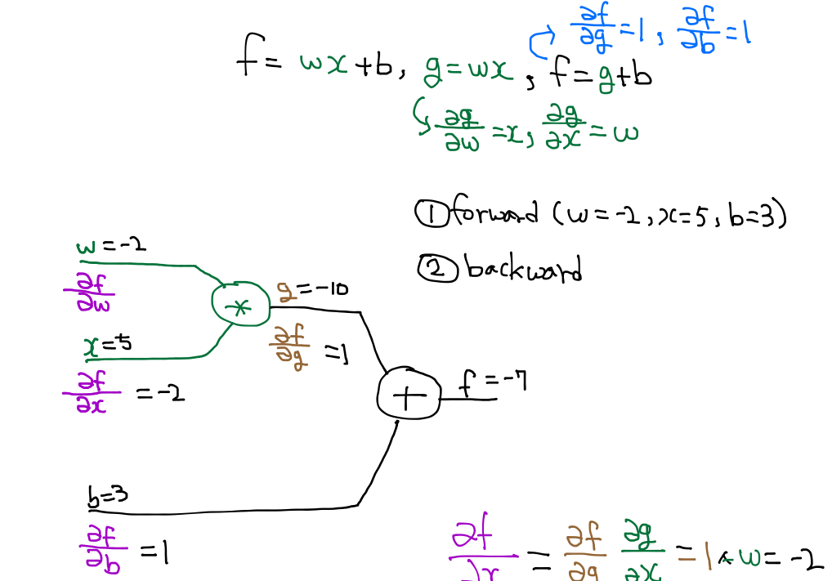
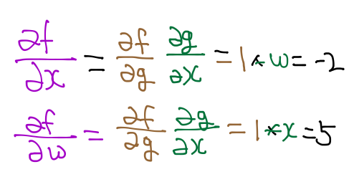
Back propagation (chain rule)
w
http://cs231n.stanford.edu/

Slide 55
Back propagation (chain rule)
w
http://cs231n.stanford.edu/

Slide 56



Logistic Regression Network
a₀
*
+
Sigmoid
loss
w
b
Notes:
E=loss(a_1, t) = -\sum{t*log(a_1) + (1-t)*log(1-a_1)}
(1)\frac{\partial{E}}{\partial{a_1}}
(2)\frac{\partial{E}}{\partial{l}}={\color{blue}\frac{\partial{E}}{\partial{a_1}}}\frac{\partial{a_1}}{\partial{l}}
(3)\frac{\partial{E}}{\partial{b}}={\color{blue}\frac{\partial{E}}{\partial{l}}}\frac{\partial{l}}{\partial{b}}
(4)\frac{\partial{E}}{\partial{o}}={\color{blue}\frac{\partial{E}}{\partial{l}}}\frac{\partial{l}}{\partial{o}}
(5)\frac{\partial{E}}{\partial{w_2}}=\frac{\partial{E}}{\partial{o_2}}\frac{\partial{o_2}}{\partial{w_2}}
=== pre-computed- derivative
l=o+b,~\frac{\partial{l}}{\partial{o}}=1,~\frac{\partial{l}}{\partial{b}}=1
o=aw,~\frac{\partial{o}}{\partial{w}}=a,~\frac{\partial{o}}{\partial{a}}=w
o=sigmoid(l)=\frac{1}{1+e^{-l}},~\frac{\partial{a}}{\partial{l}}=a(1-a)
E=\frac{1}{2}(a-t)^2,~ \frac{\partial{E}}{\partial{a}}=a-t
E=-\sum{t*log(a)+(1-t)*log(1-a)}, ~ \frac{\partial{E}}{\partial{a}}=\frac{a-t}{a(1-a)}
=== Solutions
(1)\frac{\partial{E}}{\partial{a_1}}=\frac{a_1-t}{a_1(1-a_1)}
(2)\frac{\partial{E}}{\partial{l}}=\frac{\partial{E}}{\partial{a_1}}{\color{cyan}\frac{\partial{a_1}}{\partial{l}}}=\frac{a_1-t}{a_1(1-a_1)}*{\color{cyan} a_1(1-a_1)=a_1-t}
(3)\frac{\partial{E}}{\partial{b}}=\frac{\partial{E}}{\partial{l}}{\color{cyan}\frac{\partial{l}}{\partial{b}}}
=\frac{\partial{E}}{\partial{l}}*{\color{cyan}1}
(4)\frac{\partial{E}}{\partial{o}}=\frac{\partial{E}}{\partial{l}}{\color{cyan}\frac{\partial{l}}{\partial{o}}}
=\frac{\partial{E}}{\partial{l}}*{\color{cyan}1}
(5)\frac{\partial{E}}{\partial{w}}=\frac{\partial{E}}{\partial{o}}{\color{cyan}\frac{\partial{o}}{\partial{w}}}=\frac{\partial{E}}{\partial{o}}{\color{cyan}a_0}
=== Network update
w = w - \alpha \frac{\partial{E}}{\partial{w}}
b = b - \alpha \frac{\partial{E}}{\partial{b}}

Slide 57
Network
forward
*
(1) o=a₀*w
+
(2) l=o+b
Sigmoid
(3) a₁=sigmoid(l)
loss
(4) E=loss(a₁,t)
a₀
w
b
Forward pass, OK? Just follow (1), (2), (3) and (4)
Notes:
E=loss(a_1, t) = -\sum{t*log(a_1) + (1-t)*log(1-a_1)}
(1)\frac{\partial{E}}{\partial{a_1}}
(2)\frac{\partial{E}}{\partial{l}}={\color{blue}\frac{\partial{E}}{\partial{a_1}}}\frac{\partial{a_1}}{\partial{l}}
(3)\frac{\partial{E}}{\partial{b}}={\color{blue}\frac{\partial{E}}{\partial{l}}}\frac{\partial{l}}{\partial{b}}
(4)\frac{\partial{E}}{\partial{o}}={\color{blue}\frac{\partial{E}}{\partial{l}}}\frac{\partial{l}}{\partial{o}}
(5)\frac{\partial{E}}{\partial{w_2}}=\frac{\partial{E}}{\partial{o_2}}\frac{\partial{o_2}}{\partial{w_2}}
=== pre-computed- derivative
l=o+b,~\frac{\partial{l}}{\partial{o}}=1,~\frac{\partial{l}}{\partial{b}}=1
o=aw,~\frac{\partial{o}}{\partial{w}}=a,~\frac{\partial{o}}{\partial{a}}=w
o=sigmoid(l)=\frac{1}{1+e^{-l}},~\frac{\partial{a}}{\partial{l}}=a(1-a)
E=\frac{1}{2}(a-t)^2,~ \frac{\partial{E}}{\partial{a}}=a-t
E=-\sum{t*log(a)+(1-t)*log(1-a)}, ~ \frac{\partial{E}}{\partial{a}}=\frac{a-t}{a(1-a)}
=== Solutions
(1)\frac{\partial{E}}{\partial{a_1}}=\frac{a_1-t}{a_1(1-a_1)}
(2)\frac{\partial{E}}{\partial{l}}=\frac{\partial{E}}{\partial{a_1}}{\color{cyan}\frac{\partial{a_1}}{\partial{l}}}=\frac{a_1-t}{a_1(1-a_1)}*{\color{cyan} a_1(1-a_1)=a_1-t}
(3)\frac{\partial{E}}{\partial{b}}=\frac{\partial{E}}{\partial{l}}{\color{cyan}\frac{\partial{l}}{\partial{b}}}
=\frac{\partial{E}}{\partial{l}}*{\color{cyan}1}
(4)\frac{\partial{E}}{\partial{o}}=\frac{\partial{E}}{\partial{l}}{\color{cyan}\frac{\partial{l}}{\partial{o}}}
=\frac{\partial{E}}{\partial{l}}*{\color{cyan}1}
(5)\frac{\partial{E}}{\partial{w}}=\frac{\partial{E}}{\partial{o}}{\color{cyan}\frac{\partial{o}}{\partial{w}}}=\frac{\partial{E}}{\partial{o}}{\color{cyan}a_0}
=== Network update
w = w - \alpha \frac{\partial{E}}{\partial{w}}
b = b - \alpha \frac{\partial{E}}{\partial{b}}

Slide 58
Network
forward
*
(1) o=a₀*w
+
(2) l=o+b
Sigmoid
(3) a₁=sigmoid(l)
loss
(4) E=loss(a₁,t)
a₀
w
b
Notes:
E=loss(a_1, t) = -\sum{t*log(a_1) + (1-t)*log(1-a_1)}
(1)\frac{\partial{E}}{\partial{a_1}}
(2)\frac{\partial{E}}{\partial{l}}={\color{blue}\frac{\partial{E}}{\partial{a_1}}}\frac{\partial{a_1}}{\partial{l}}
(3)\frac{\partial{E}}{\partial{b}}={\color{blue}\frac{\partial{E}}{\partial{l}}}\frac{\partial{l}}{\partial{b}}
(4)\frac{\partial{E}}{\partial{o}}={\color{blue}\frac{\partial{E}}{\partial{l}}}\frac{\partial{l}}{\partial{o}}
(5)\frac{\partial{E}}{\partial{w_2}}=\frac{\partial{E}}{\partial{o_2}}\frac{\partial{o_2}}{\partial{w_2}}
=== pre-computed- derivative
l=o+b,~\frac{\partial{l}}{\partial{o}}=1,~\frac{\partial{l}}{\partial{b}}=1
o=aw,~\frac{\partial{o}}{\partial{w}}=a,~\frac{\partial{o}}{\partial{a}}=w
o=sigmoid(l)=\frac{1}{1+e^{-l}},~\frac{\partial{a}}{\partial{l}}=a(1-a)
E=\frac{1}{2}(a-t)^2,~ \frac{\partial{E}}{\partial{a}}=a-t
E=-\sum{t*log(a)+(1-t)*log(1-a)}, ~ \frac{\partial{E}}{\partial{a}}=\frac{a-t}{a(1-a)}
=== Solutions
(1)\frac{\partial{E}}{\partial{a_1}}=\frac{a_1-t}{a_1(1-a_1)}
(2)\frac{\partial{E}}{\partial{l}}=\frac{\partial{E}}{\partial{a_1}}{\color{cyan}\frac{\partial{a_1}}{\partial{l}}}=\frac{a_1-t}{a_1(1-a_1)}*{\color{cyan} a_1(1-a_1)=a_1-t}
(3)\frac{\partial{E}}{\partial{b}}=\frac{\partial{E}}{\partial{l}}{\color{cyan}\frac{\partial{l}}{\partial{b}}}
=\frac{\partial{E}}{\partial{l}}*{\color{cyan}1}
(4)\frac{\partial{E}}{\partial{o}}=\frac{\partial{E}}{\partial{l}}{\color{cyan}\frac{\partial{l}}{\partial{o}}}
=\frac{\partial{E}}{\partial{l}}*{\color{cyan}1}
(5)\frac{\partial{E}}{\partial{w}}=\frac{\partial{E}}{\partial{o}}{\color{cyan}\frac{\partial{o}}{\partial{w}}}=\frac{\partial{E}}{\partial{o}}{\color{cyan}a_0}
=== Network update
w = w - \alpha \frac{\partial{E}}{\partial{w}}
b = b - \alpha \frac{\partial{E}}{\partial{b}}

Slide 59
Network
forward
*
(1) o=a₀*w
+
(2) l=o+b
Sigmoid
(3) a₁=sigmoid(l)
loss
(4) E=loss(a₁,t)
a₀
w
b
Notes:
(1)\frac{\partial{E}}{\partial{a_1}}
(2)\frac{\partial{E}}{\partial{l}}={\color{blue}\frac{\partial{E}}{\partial{a_1}}}\frac{\partial{a_1}}{\partial{l}}
(3)\frac{\partial{E}}{\partial{b}}={\color{blue}\frac{\partial{E}}{\partial{l}}}\frac{\partial{l}}{\partial{b}}
(4)\frac{\partial{E}}{\partial{o}}={\color{blue}\frac{\partial{E}}{\partial{l}}}\frac{\partial{l}}{\partial{o}}
(5)\frac{\partial{E}}{\partial{w_2}}=\frac{\partial{E}}{\partial{o_2}}\frac{\partial{o_2}}{\partial{w_2}}
=== pre-computed- derivative
l=o+b,~\frac{\partial{l}}{\partial{o}}=1,~\frac{\partial{l}}{\partial{b}}=1
o=aw,~\frac{\partial{o}}{\partial{w}}=a,~\frac{\partial{o}}{\partial{a}}=w
o=sigmoid(l)=\frac{1}{1+e^{-l}},~\frac{\partial{a}}{\partial{l}}=a(1-a)
E=\frac{1}{2}(a-t)^2,~ \frac{\partial{E}}{\partial{a}}=a-t
E=-\sum{t*log(a)+(1-t)*log(1-a)}, ~ \frac{\partial{E}}{\partial{a}}=\frac{a-t}{a(1-a)}
=== Solutions
(1)\frac{\partial{E}}{\partial{a_1}}=\frac{a_1-t}{a_1(1-a_1)}
(2)\frac{\partial{E}}{\partial{l}}=\frac{\partial{E}}{\partial{a_1}}{\color{cyan}\frac{\partial{a_1}}{\partial{l}}}=\frac{a_1-t}{a_1(1-a_1)}*{\color{cyan} a_1(1-a_1)=a_1-t}
(3)\frac{\partial{E}}{\partial{b}}=\frac{\partial{E}}{\partial{l}}{\color{cyan}\frac{\partial{l}}{\partial{b}}}
=\frac{\partial{E}}{\partial{l}}*{\color{cyan}1}
(4)\frac{\partial{E}}{\partial{o}}=\frac{\partial{E}}{\partial{l}}{\color{cyan}\frac{\partial{l}}{\partial{o}}}
=\frac{\partial{E}}{\partial{l}}*{\color{cyan}1}
(5)\frac{\partial{E}}{\partial{w}}=\frac{\partial{E}}{\partial{o}}{\color{cyan}\frac{\partial{o}}{\partial{w}}}=\frac{\partial{E}}{\partial{o}}{\color{cyan}a_0}
=== Network update
w = w - \alpha \frac{\partial{E}}{\partial{w}}
b = b - \alpha \frac{\partial{E}}{\partial{b}}

Slide 60
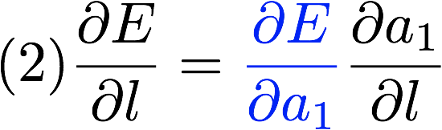
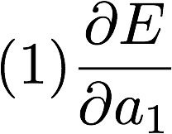
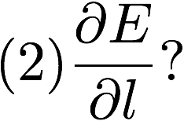
Network
forward
*
(1) o=a₀*w
+
(2) l=o+b
Sigmoid
(3) a₁=sigmoid(l)
loss
(4) E=loss(a₁,t)
a₀
w
b
backward prop
Let’s do back propagation!
will be given. What would be
We can use the chain rule.
Notes:
(1)\frac{\partial{E}}{\partial{a_1}}
(2)\frac{\partial{E}}{\partial{l}}={\color{blue}\frac{\partial{E}}{\partial{a_1}}}\frac{\partial{a_1}}{\partial{l}}
(3)\frac{\partial{E}}{\partial{b}}={\color{blue}\frac{\partial{E}}{\partial{l}}}\frac{\partial{l}}{\partial{b}}
(4)\frac{\partial{E}}{\partial{o}}={\color{blue}\frac{\partial{E}}{\partial{l}}}\frac{\partial{l}}{\partial{o}}
(5)\frac{\partial{E}}{\partial{w_2}}=\frac{\partial{E}}{\partial{o_2}}\frac{\partial{o_2}}{\partial{w_2}}
=== pre-computed- derivative
l=o+b,~\frac{\partial{l}}{\partial{o}}=1,~\frac{\partial{l}}{\partial{b}}=1
o=aw,~\frac{\partial{o}}{\partial{w}}=a,~\frac{\partial{o}}{\partial{a}}=w
o=sigmoid(l)=\frac{1}{1+e^{-l}},~\frac{\partial{a}}{\partial{l}}=a(1-a)
E=\frac{1}{2}(a-t)^2,~ \frac{\partial{E}}{\partial{a}}=a-t
E=-\sum{t*log(a)+(1-t)*log(1-a)}, ~ \frac{\partial{E}}{\partial{a}}=\frac{a-t}{a(1-a)}
=== Solutions
(1)\frac{\partial{E}}{\partial{a_1}}=\frac{a_1-t}{a_1(1-a_1)}
(2)\frac{\partial{E}}{\partial{l}}=\frac{\partial{E}}{\partial{a_1}}{\color{cyan}\frac{\partial{a_1}}{\partial{l}}}=\frac{a_1-t}{a_1(1-a_1)}*{\color{cyan} a_1(1-a_1)=a_1-t}
(3)\frac{\partial{E}}{\partial{b}}=\frac{\partial{E}}{\partial{l}}{\color{cyan}\frac{\partial{l}}{\partial{b}}}
=\frac{\partial{E}}{\partial{l}}*{\color{cyan}1}
(4)\frac{\partial{E}}{\partial{o}}=\frac{\partial{E}}{\partial{l}}{\color{cyan}\frac{\partial{l}}{\partial{o}}}
=\frac{\partial{E}}{\partial{l}}*{\color{cyan}1}
(5)\frac{\partial{E}}{\partial{w}}=\frac{\partial{E}}{\partial{o}}{\color{cyan}\frac{\partial{o}}{\partial{w}}}=\frac{\partial{E}}{\partial{o}}{\color{cyan}a_0}
=== Network update
w = w - \alpha \frac{\partial{E}}{\partial{w}}
b = b - \alpha \frac{\partial{E}}{\partial{b}}

Slide 61
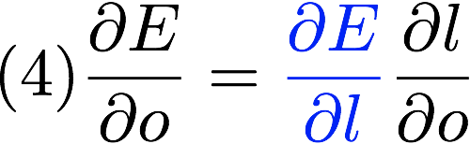
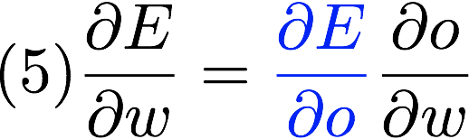
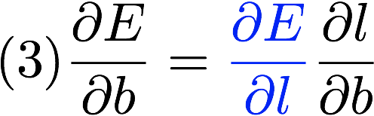
Network
forward
*
(1) o=a₀*w
+
(2) l=o+b
Sigmoid
(3) a₁=sigmoid(l)
loss
(4) E=loss(a₁,t)
a₀
w
b
backward prop
In the same manner, we can get back prop (4), (3), (1) and (1)!
Notes:
(1)\frac{\partial{E}}{\partial{a_1}}
(2)\frac{\partial{E}}{\partial{l}}={\color{blue}\frac{\partial{E}}{\partial{a_1}}}\frac{\partial{a_1}}{\partial{l}}
(3)\frac{\partial{E}}{\partial{b}}={\color{blue}\frac{\partial{E}}{\partial{l}}}\frac{\partial{l}}{\partial{b}}
(4)\frac{\partial{E}}{\partial{o}}={\color{blue}\frac{\partial{E}}{\partial{l}}}\frac{\partial{l}}{\partial{o}}
(5)\frac{\partial{E}}{\partial{w_2}}=\frac{\partial{E}}{\partial{o_2}}\frac{\partial{o_2}}{\partial{w_2}}
=== pre-computed- derivative
l=o+b,~\frac{\partial{l}}{\partial{o}}=1,~\frac{\partial{l}}{\partial{b}}=1
o=aw,~\frac{\partial{o}}{\partial{w}}=a,~\frac{\partial{o}}{\partial{a}}=w
o=sigmoid(l)=\frac{1}{1+e^{-l}},~\frac{\partial{a}}{\partial{l}}=a(1-a)
E=\frac{1}{2}(a-t)^2,~ \frac{\partial{E}}{\partial{a}}=a-t
E=-\sum{t*log(a)+(1-t)*log(1-a)}, ~ \frac{\partial{E}}{\partial{a}}=\frac{a-t}{a(1-a)}
=== Solutions
(1)\frac{\partial{E}}{\partial{a_1}}=\frac{a_1-t}{a_1(1-a_1)}
(2)\frac{\partial{E}}{\partial{l}}=\frac{\partial{E}}{\partial{a_1}}{\color{cyan}\frac{\partial{a_1}}{\partial{l}}}=\frac{a_1-t}{a_1(1-a_1)}*{\color{cyan} a_1(1-a_1)=a_1-t}
(3)\frac{\partial{E}}{\partial{b}}=\frac{\partial{E}}{\partial{l}}{\color{cyan}\frac{\partial{l}}{\partial{b}}}
=\frac{\partial{E}}{\partial{l}}*{\color{cyan}1}
(4)\frac{\partial{E}}{\partial{o}}=\frac{\partial{E}}{\partial{l}}{\color{cyan}\frac{\partial{l}}{\partial{o}}}
=\frac{\partial{E}}{\partial{l}}*{\color{cyan}1}
(5)\frac{\partial{E}}{\partial{w}}=\frac{\partial{E}}{\partial{o}}{\color{cyan}\frac{\partial{o}}{\partial{w}}}=\frac{\partial{E}}{\partial{o}}{\color{cyan}a_0}
=== Network update
w = w - \alpha \frac{\partial{E}}{\partial{w}}
b = b - \alpha \frac{\partial{E}}{\partial{b}}

Slide 62
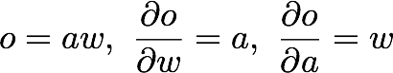
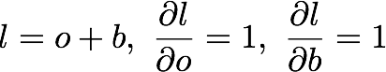
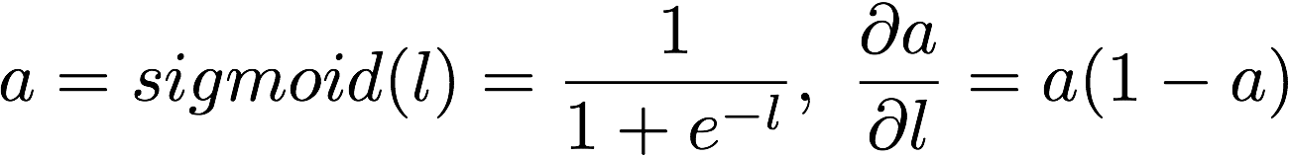
Network
forward
*
(1) o=a₀*w
+
(2) l=o+b
Sigmoid
(3) a₁=sigmoid(l)
loss
(4) E=loss(a₁,t)
a₀
w
b
Gate derivatives
These derivatives for each gate will be given.
We can just use them in the chain rule.
Notes:
(1)\frac{\partial{E}}{\partial{a_1}}
(2)\frac{\partial{E}}{\partial{l}}={\color{blue}\frac{\partial{E}}{\partial{a_1}}}\frac{\partial{a_1}}{\partial{l}}
(3)\frac{\partial{E}}{\partial{b}}={\color{blue}\frac{\partial{E}}{\partial{l}}}\frac{\partial{l}}{\partial{b}}
(4)\frac{\partial{E}}{\partial{o}}={\color{blue}\frac{\partial{E}}{\partial{l}}}\frac{\partial{l}}{\partial{o}}
(5)\frac{\partial{E}}{\partial{w_2}}=\frac{\partial{E}}{\partial{o_2}}\frac{\partial{o_2}}{\partial{w_2}}
=== pre-computed- derivative
l=o+b,~\frac{\partial{l}}{\partial{o}}=1,~\frac{\partial{l}}{\partial{b}}=1
o=aw,~\frac{\partial{o}}{\partial{w}}=a,~\frac{\partial{o}}{\partial{a}}=w
o=sigmoid(l)=\frac{1}{1+e^{-l}},~\frac{\partial{a}}{\partial{l}}=a(1-a)
E=\frac{1}{2}(a-t)^2,~ \frac{\partial{E}}{\partial{a}}=a-t
E=-\sum{t*log(a)+(1-t)*log(1-a)}, ~ \frac{\partial{E}}{\partial{a}}=\frac{a-t}{a(1-a)}
=== Solutions
(1)\frac{\partial{E}}{\partial{a_1}}=\frac{a_1-t}{a_1(1-a_1)}
(2)\frac{\partial{E}}{\partial{l}}=\frac{\partial{E}}{\partial{a_1}}{\color{cyan}\frac{\partial{a_1}}{\partial{l}}}=\frac{a_1-t}{a_1(1-a_1)}*{\color{cyan} a_1(1-a_1)=a_1-t}
(3)\frac{\partial{E}}{\partial{b}}=\frac{\partial{E}}{\partial{l}}{\color{cyan}\frac{\partial{l}}{\partial{b}}}
=\frac{\partial{E}}{\partial{l}}*{\color{cyan}1}
(4)\frac{\partial{E}}{\partial{o}}=\frac{\partial{E}}{\partial{l}}{\color{cyan}\frac{\partial{l}}{\partial{o}}}
=\frac{\partial{E}}{\partial{l}}*{\color{cyan}1}
(5)\frac{\partial{E}}{\partial{w}}=\frac{\partial{E}}{\partial{o}}{\color{cyan}\frac{\partial{o}}{\partial{w}}}=\frac{\partial{E}}{\partial{o}}{\color{cyan}a_0}
=== Network update
w = w - \alpha \frac{\partial{E}}{\partial{w}}
b = b - \alpha \frac{\partial{E}}{\partial{b}}

Slide 63
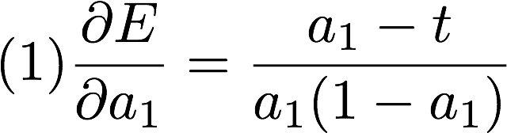
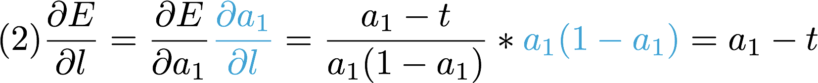
Network
forward
*
(1) o=a₀*w
+
(2) l=o+b
Sigmoid
(3) a₁=sigmoid(l)
loss
(4) E=loss(a₁,t)
a₀
w
b
backward prop
Derivatives (chain rule)
Gate derivatives
Given from the pre computed derivative
Just apply them one by one and solve each derivative one by one!
Notes:
(1)\frac{\partial{E}}{\partial{a_1}}
(2)\frac{\partial{E}}{\partial{l}}={\color{blue}\frac{\partial{E}}{\partial{a_1}}}\frac{\partial{a_1}}{\partial{l}}
(3)\frac{\partial{E}}{\partial{b}}={\color{blue}\frac{\partial{E}}{\partial{l}}}\frac{\partial{l}}{\partial{b}}
(4)\frac{\partial{E}}{\partial{o}}={\color{blue}\frac{\partial{E}}{\partial{l}}}\frac{\partial{l}}{\partial{o}}
(5)\frac{\partial{E}}{\partial{w_2}}=\frac{\partial{E}}{\partial{o_2}}\frac{\partial{o_2}}{\partial{w_2}}
=== pre-computed- derivative
l=o+b,~\frac{\partial{l}}{\partial{o}}=1,~\frac{\partial{l}}{\partial{b}}=1
o=aw,~\frac{\partial{o}}{\partial{w}}=a,~\frac{\partial{o}}{\partial{a}}=w
o=sigmoid(l)=\frac{1}{1+e^{-l}},~\frac{\partial{a}}{\partial{l}}=a(1-a)
E=\frac{1}{2}(a-t)^2,~ \frac{\partial{E}}{\partial{a}}=a-t
E=-\sum{t*log(a)+(1-t)*log(1-a)}, ~ \frac{\partial{E}}{\partial{a}}=\frac{a-t}{a(1-a)}
=== Solutions
(1)\frac{\partial{E}}{\partial{a_1}}=\frac{a_1-t}{a_1(1-a_1)}
(2)\frac{\partial{E}}{\partial{l}}=\frac{\partial{E}}{\partial{a_1}}{\color{cyan}\frac{\partial{a_1}}{\partial{l}}}=\frac{a_1-t}{a_1(1-a_1)}*{\color{cyan} a_1(1-a_1)=a_1-t}
(3)\frac{\partial{E}}{\partial{b}}=\frac{\partial{E}}{\partial{l}}{\color{cyan}\frac{\partial{l}}{\partial{b}}}
=\frac{\partial{E}}{\partial{l}}*{\color{cyan}1}
(4)\frac{\partial{E}}{\partial{o}}=\frac{\partial{E}}{\partial{l}}{\color{cyan}\frac{\partial{l}}{\partial{o}}}
=\frac{\partial{E}}{\partial{l}}*{\color{cyan}1}
(5)\frac{\partial{E}}{\partial{w}}=\frac{\partial{E}}{\partial{o}}{\color{cyan}\frac{\partial{o}}{\partial{w}}}=\frac{\partial{E}}{\partial{o}}{\color{cyan}a_0}
=== Network update
w = w - \alpha \frac{\partial{E}}{\partial{w}}
b = b - \alpha \frac{\partial{E}}{\partial{b}}

Slide 64
Network
forward
*
(1) o=a₀*w
+
(2) l=o+b
Sigmoid
(3) a₁=sigmoid(l)
loss
(4) E=loss(a₁,t)
a₀
w
b
backward prop
Derivatives (chain rule)
Gate derivatives
Given from the pre computed derivative
Given
Just apply them one by one and solve each derivative one by one!
Notes:
(1)\frac{\partial{E}}{\partial{a_1}}
(2)\frac{\partial{E}}{\partial{l}}={\color{blue}\frac{\partial{E}}{\partial{a_1}}}\frac{\partial{a_1}}{\partial{l}}
(3)\frac{\partial{E}}{\partial{b}}={\color{blue}\frac{\partial{E}}{\partial{l}}}\frac{\partial{l}}{\partial{b}}
(4)\frac{\partial{E}}{\partial{o}}={\color{blue}\frac{\partial{E}}{\partial{l}}}\frac{\partial{l}}{\partial{o}}
(5)\frac{\partial{E}}{\partial{w_2}}=\frac{\partial{E}}{\partial{o_2}}\frac{\partial{o_2}}{\partial{w_2}}
=== pre-computed- derivative
l=o+b,~\frac{\partial{l}}{\partial{o}}=1,~\frac{\partial{l}}{\partial{b}}=1
o=aw,~\frac{\partial{o}}{\partial{w}}=a,~\frac{\partial{o}}{\partial{a}}=w
o=sigmoid(l)=\frac{1}{1+e^{-l}},~\frac{\partial{a}}{\partial{l}}=a(1-a)
E=\frac{1}{2}(a-t)^2,~ \frac{\partial{E}}{\partial{a}}=a-t
E=-\sum{t*log(a)+(1-t)*log(1-a)}, ~ \frac{\partial{E}}{\partial{a}}=\frac{a-t}{a(1-a)}
=== Solutions
(1)\frac{\partial{E}}{\partial{a_1}}=\frac{a_1-t}{a_1(1-a_1)}
(2)\frac{\partial{E}}{\partial{l}}=\frac{\partial{E}}{\partial{a_1}}{\color{cyan}\frac{\partial{a_1}}{\partial{l}}}=\frac{a_1-t}{a_1(1-a_1)}*{\color{cyan} a_1(1-a_1)=a_1-t}
(3)\frac{\partial{E}}{\partial{b}}=\frac{\partial{E}}{\partial{l}}{\color{cyan}\frac{\partial{l}}{\partial{b}}}
=\frac{\partial{E}}{\partial{l}}*{\color{cyan}1}
(4)\frac{\partial{E}}{\partial{o}}=\frac{\partial{E}}{\partial{l}}{\color{cyan}\frac{\partial{l}}{\partial{o}}}
=\frac{\partial{E}}{\partial{l}}*{\color{cyan}1}
(5)\frac{\partial{E}}{\partial{w}}=\frac{\partial{E}}{\partial{o}}{\color{cyan}\frac{\partial{o}}{\partial{w}}}=\frac{\partial{E}}{\partial{o}}{\color{cyan}a_0}
=== Network update
w = w - \alpha \frac{\partial{E}}{\partial{w}}
b = b - \alpha \frac{\partial{E}}{\partial{b}}

Slide 65
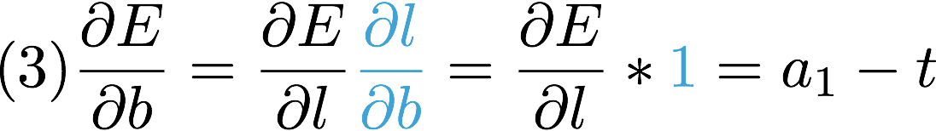
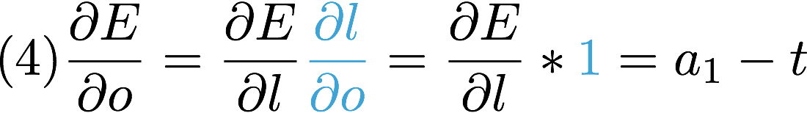
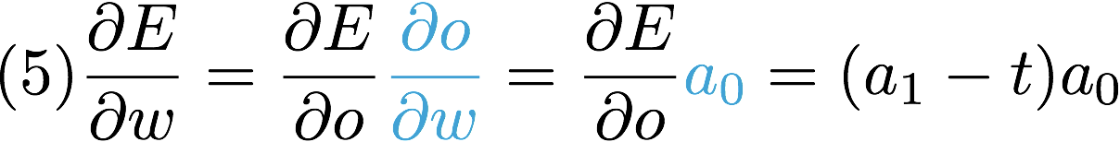
Network
forward
*
(1) o=a₀*w
+
(2) l=o+b
Sigmoid
(3) a₁=sigmoid(l)
loss
(4) E=loss(a₁,t)
a₀
w
b
backward prop
Derivatives (chain rule)
Gate derivatives
Given from the pre computed derivative
Given
Just apply them one by one and solve each derivative one by one!
Notes:
(1)\frac{\partial{E}}{\partial{a_1}}
(2)\frac{\partial{E}}{\partial{l}}={\color{blue}\frac{\partial{E}}{\partial{a_1}}}\frac{\partial{a_1}}{\partial{l}}
(3)\frac{\partial{E}}{\partial{b}}={\color{blue}\frac{\partial{E}}{\partial{l}}}\frac{\partial{l}}{\partial{b}}
(4)\frac{\partial{E}}{\partial{o}}={\color{blue}\frac{\partial{E}}{\partial{l}}}\frac{\partial{l}}{\partial{o}}
(5)\frac{\partial{E}}{\partial{w_2}}=\frac{\partial{E}}{\partial{o_2}}\frac{\partial{o_2}}{\partial{w_2}}
=== pre-computed- derivative
l=o+b,~\frac{\partial{l}}{\partial{o}}=1,~\frac{\partial{l}}{\partial{b}}=1
o=aw,~\frac{\partial{o}}{\partial{w}}=a,~\frac{\partial{o}}{\partial{a}}=w
o=sigmoid(l)=\frac{1}{1+e^{-l}},~\frac{\partial{a}}{\partial{l}}=a(1-a)
E=\frac{1}{2}(a-t)^2,~ \frac{\partial{E}}{\partial{a}}=a-t
E=-\sum{t*log(a)+(1-t)*log(1-a)}, ~ \frac{\partial{E}}{\partial{a}}=\frac{a-t}{a(1-a)}
=== Solutions
(1)\frac{\partial{E}}{\partial{a_1}}=\frac{a_1-t}{a_1(1-a_1)}
(2)\frac{\partial{E}}{\partial{l}}=\frac{\partial{E}}{\partial{a_1}}{\color{cyan}\frac{\partial{a_1}}{\partial{l}}}=\frac{a_1-t}{a_1(1-a_1)}*{\color{cyan} a_1(1-a_1)=a_1-t}
(3)\frac{\partial{E}}{\partial{b}}=\frac{\partial{E}}{\partial{l}}{\color{cyan}\frac{\partial{l}}{\partial{b}}}
=\frac{\partial{E}}{\partial{l}}*{\color{cyan}1}
(4)\frac{\partial{E}}{\partial{o}}=\frac{\partial{E}}{\partial{l}}{\color{cyan}\frac{\partial{l}}{\partial{o}}}
=\frac{\partial{E}}{\partial{l}}*{\color{cyan}1}
(5)\frac{\partial{E}}{\partial{w}}=\frac{\partial{E}}{\partial{o}}{\color{cyan}\frac{\partial{o}}{\partial{w}}}=\frac{\partial{E}}{\partial{o}}{\color{cyan}a_0}
=== Network update
w = w - \alpha \frac{\partial{E}}{\partial{w}}
b = b - \alpha \frac{\partial{E}}{\partial{b}}

Slide 66
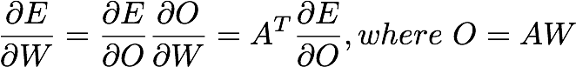
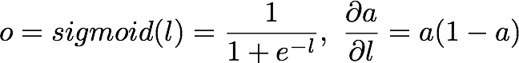
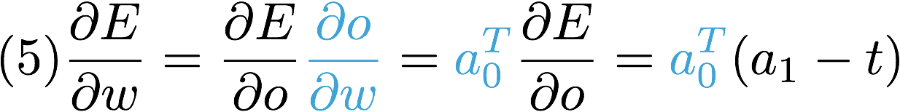
Network
forward
*
(1) o=a₀*w
+
(2) l=o+b
Sigmoid
(3) a₁=sigmoid(l)
loss
(4) E=loss(a₁,t)
a₀
w
b
backward prop
Derivatives (chain rule)
Gate derivatives
Matrix
For Matrix: http://cs231n.github.io/optimization-2/#staged
Notes:
(1)\frac{\partial{E}}{\partial{a_1}}
(2)\frac{\partial{E}}{\partial{l}}={\color{blue}\frac{\partial{E}}{\partial{a_1}}}\frac{\partial{a_1}}{\partial{l}}
(3)\frac{\partial{E}}{\partial{b}}={\color{blue}\frac{\partial{E}}{\partial{l}}}\frac{\partial{l}}{\partial{b}}
(4)\frac{\partial{E}}{\partial{o}}={\color{blue}\frac{\partial{E}}{\partial{l}}}\frac{\partial{l}}{\partial{o}}
(5)\frac{\partial{E}}{\partial{w_2}}=\frac{\partial{E}}{\partial{o_2}}\frac{\partial{o_2}}{\partial{w_2}}
=== pre-computed- derivative
l=o+b,~\frac{\partial{l}}{\partial{o}}=1,~\frac{\partial{l}}{\partial{b}}=1
o=aw,~\frac{\partial{o}}{\partial{w}}=a,~\frac{\partial{o}}{\partial{a}}=w
o=sigmoid(l)=\frac{1}{1+e^{-l}},~\frac{\partial{a}}{\partial{l}}=a(1-a)
E=\frac{1}{2}(a-t)^2,~ \frac{\partial{E}}{\partial{a}}=a-t
E=-\sum{t*log(a)+(1-t)*log(1-a)}, ~ \frac{\partial{E}}{\partial{a}}=\frac{a-t}{a(1-a)}
=== Solutions
(1)\frac{\partial{E}}{\partial{a_1}}=\frac{a_1-t}{a_1(1-a_1)}
(2)\frac{\partial{E}}{\partial{l}}=\frac{\partial{E}}{\partial{a_1}}{\color{cyan}\frac{\partial{a_1}}{\partial{l}}}=\frac{a_1-t}{a_1(1-a_1)}*{\color{cyan} a_1(1-a_1)=a_1-t}
(3)\frac{\partial{E}}{\partial{b}}=\frac{\partial{E}}{\partial{l}}{\color{cyan}\frac{\partial{l}}{\partial{b}}}
=\frac{\partial{E}}{\partial{l}}*{\color{cyan}1}
(4)\frac{\partial{E}}{\partial{o}}=\frac{\partial{E}}{\partial{l}}{\color{cyan}\frac{\partial{l}}{\partial{o}}}
=\frac{\partial{E}}{\partial{l}}*{\color{cyan}1}
(5)\frac{\partial{E}}{\partial{w}}=\frac{\partial{E}}{\partial{o}}{\color{cyan}\frac{\partial{o}}{\partial{w}}}=\frac{\partial{E}}{\partial{o}}{\color{cyan}a_0}
(5)\frac{\partial{E}}{\partial{w}}=\frac{\partial{E}}{\partial{o}}{\color{cyan}\frac{\partial{o}}{\partial{w}}}={\color{cyan}a_0^T}\frac{\partial{E}}{\partial{o}}={\color{cyan}a_0^T}(a_1-t)
=== Network update
w = w - \alpha \frac{\partial{E}}{\partial{w}}
b = b - \alpha \frac{\partial{E}}{\partial{b}}

Slide 67
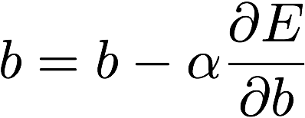
Network
forward
*
(1) o=a₀*w
+
(2) l=o+b
Sigmoid
(3) a₁=sigmoid(l)
loss
(4) E=loss(a₁,t)
a₀
w
b
backward prop
Derivatives (chain rule)
Gate derivatives
Matrix
Network update (learning rate, alpha)
Notes:
(1)\frac{\partial{E}}{\partial{a_1}}
(2)\frac{\partial{E}}{\partial{l}}={\color{blue}\frac{\partial{E}}{\partial{a_1}}}\frac{\partial{a_1}}{\partial{l}}
(3)\frac{\partial{E}}{\partial{b}}={\color{blue}\frac{\partial{E}}{\partial{l}}}\frac{\partial{l}}{\partial{b}}
(4)\frac{\partial{E}}{\partial{o}}={\color{blue}\frac{\partial{E}}{\partial{l}}}\frac{\partial{l}}{\partial{o}}
(5)\frac{\partial{E}}{\partial{w_2}}=\frac{\partial{E}}{\partial{o_2}}\frac{\partial{o_2}}{\partial{w_2}}
=== pre-computed- derivative
l=o+b,~\frac{\partial{l}}{\partial{o}}=1,~\frac{\partial{l}}{\partial{b}}=1
o=aw,~\frac{\partial{o}}{\partial{w}}=a,~\frac{\partial{o}}{\partial{a}}=w
o=sigmoid(l)=\frac{1}{1+e^{-l}},~\frac{\partial{a}}{\partial{l}}=a(1-a)
E=\frac{1}{2}(a-t)^2,~ \frac{\partial{E}}{\partial{a}}=a-t
E=-\sum{t*log(a)+(1-t)*log(1-a)}, ~ \frac{\partial{E}}{\partial{a}}=\frac{a-t}{a(1-a)}
=== Solutions
(1)\frac{\partial{E}}{\partial{a_1}}=\frac{a_1-t}{a_1(1-a_1)}
(2)\frac{\partial{E}}{\partial{l}}=\frac{\partial{E}}{\partial{a_1}}{\color{cyan}\frac{\partial{a_1}}{\partial{l}}}=\frac{a_1-t}{a_1(1-a_1)}*{\color{cyan} a_1(1-a_1)=a_1-t}
(3)\frac{\partial{E}}{\partial{b}}=\frac{\partial{E}}{\partial{l}}{\color{cyan}\frac{\partial{l}}{\partial{b}}}
=\frac{\partial{E}}{\partial{l}}*{\color{cyan}1}
(4)\frac{\partial{E}}{\partial{o}}=\frac{\partial{E}}{\partial{l}}{\color{cyan}\frac{\partial{l}}{\partial{o}}}
=\frac{\partial{E}}{\partial{l}}*{\color{cyan}1}
(5)\frac{\partial{E}}{\partial{w}}=\frac{\partial{E}}{\partial{o}}{\color{cyan}\frac{\partial{o}}{\partial{w}}}=\frac{\partial{E}}{\partial{o}}{\color{cyan}a_0}
(5)\frac{\partial{E}}{\partial{w}}=\frac{\partial{E}}{\partial{o}}{\color{cyan}\frac{\partial{o}}{\partial{w}}}={\color{cyan}a_0^T}\frac{\partial{E}}{\partial{o}}={\color{cyan}a_0^T}(a_1-t)
=== Network update
w = w - \alpha \frac{\partial{E}}{\partial{w}}
b = b - \alpha \frac{\partial{E}}{\partial{b}}

Slide 68
Network
forward
*
(1) o=a₀*w
+
(2) l=o+b
Sigmoid
(3) a₁=sigmoid(l)
loss
(4) E=loss(a₁,t)
a₀
w
b
backward prop
Derivatives (chain rule)
Gate derivatives
Done! Let’s update our network using derivatives!
Network update (learning rate, alpha)
Notes:
(1)\frac{\partial{E}}{\partial{a_1}}
(2)\frac{\partial{E}}{\partial{l}}={\color{blue}\frac{\partial{E}}{\partial{a_1}}}\frac{\partial{a_1}}{\partial{l}}
(3)\frac{\partial{E}}{\partial{b}}={\color{blue}\frac{\partial{E}}{\partial{l}}}\frac{\partial{l}}{\partial{b}}
(4)\frac{\partial{E}}{\partial{o}}={\color{blue}\frac{\partial{E}}{\partial{l}}}\frac{\partial{l}}{\partial{o}}
(5)\frac{\partial{E}}{\partial{w_2}}=\frac{\partial{E}}{\partial{o_2}}\frac{\partial{o_2}}{\partial{w_2}}
=== pre-computed- derivative
l=o+b,~\frac{\partial{l}}{\partial{o}}=1,~\frac{\partial{l}}{\partial{b}}=1
o=aw,~\frac{\partial{o}}{\partial{w}}=a,~\frac{\partial{o}}{\partial{a}}=w
o=sigmoid(l)=\frac{1}{1+e^{-l}},~\frac{\partial{a}}{\partial{l}}=a(1-a)
E=\frac{1}{2}(a-t)^2,~ \frac{\partial{E}}{\partial{a}}=a-t
E=-\sum{t*log(a)+(1-t)*log(1-a)}, ~ \frac{\partial{E}}{\partial{a}}=\frac{a-t}{a(1-a)}
=== Solutions
(1)\frac{\partial{E}}{\partial{a_1}}=\frac{a_1-t}{a_1(1-a_1)}
(2)\frac{\partial{E}}{\partial{l}}=\frac{\partial{E}}{\partial{a_1}}{\color{cyan}\frac{\partial{a_1}}{\partial{l}}}=\frac{a_1-t}{a_1(1-a_1)}*{\color{cyan} a_1(1-a_1)=a_1-t}
(3)\frac{\partial{E}}{\partial{b}}=\frac{\partial{E}}{\partial{l}}{\color{cyan}\frac{\partial{l}}{\partial{b}}}
=\frac{\partial{E}}{\partial{l}}*{\color{cyan}1}
(4)\frac{\partial{E}}{\partial{o}}=\frac{\partial{E}}{\partial{l}}{\color{cyan}\frac{\partial{l}}{\partial{o}}}
=\frac{\partial{E}}{\partial{l}}*{\color{cyan}1}
(5)\frac{\partial{E}}{\partial{w}}=\frac{\partial{E}}{\partial{o}}{\color{cyan}\frac{\partial{o}}{\partial{w}}}=\frac{\partial{E}}{\partial{o}}{\color{cyan}a_0}
=== Network update
w = w - \alpha \frac{\partial{E}}{\partial{w}}
b = b - \alpha \frac{\partial{E}}{\partial{b}}

Slide 69
Network
forward
*
(1) o=a₀*w
+
(2) l=o+b
Sigmoid
(3) a₁=sigmoid(l)
loss
(4) E=loss(a₁,t)
a₀
w
b
backward prop
Derivatives (chain rule)
d_a1 = (a1 - t) / (a1 * (1. - t) + 1e-7)
d_sigma = a1 * (1 - a1) # sigma prime
d_l = d_a1 * d_sigma # (a1 - t)
d_b = d_l * 1
d_o = d_1 * 1
d_W = tf.matmul(tf.transpose(a0), d_o)
# Updating network using gradients
learning_rate = 0.01
train_step = [
tf.assign(W, W - learning_rate * d_W),
tf.assign(b, b - learning_rate * tf.reduce_sum(d_b))]
Notes:
(1)\frac{\partial{E}}{\partial{a_1}}
(2)\frac{\partial{E}}{\partial{l}}={\color{blue}\frac{\partial{E}}{\partial{a_1}}}\frac{\partial{a_1}}{\partial{l}}
(3)\frac{\partial{E}}{\partial{b}}={\color{blue}\frac{\partial{E}}{\partial{l}}}\frac{\partial{l}}{\partial{b}}
(4)\frac{\partial{E}}{\partial{o}}={\color{blue}\frac{\partial{E}}{\partial{l}}}\frac{\partial{l}}{\partial{o}}
(5)\frac{\partial{E}}{\partial{w_2}}=\frac{\partial{E}}{\partial{o_2}}\frac{\partial{o_2}}{\partial{w_2}}
=== pre-computed- derivative
l=o+b,~\frac{\partial{l}}{\partial{o}}=1,~\frac{\partial{l}}{\partial{b}}=1
o=aw,~\frac{\partial{o}}{\partial{w}}=a,~\frac{\partial{o}}{\partial{a}}=w
o=sigmoid(l)=\frac{1}{1+e^{-l}},~\frac{\partial{a}}{\partial{l}}=a(1-a)
E=\frac{1}{2}(a-t)^2,~ \frac{\partial{E}}{\partial{a}}=a-t
E=-\sum{t*log(a)+(1-t)*log(1-a)}, ~ \frac{\partial{E}}{\partial{a}}=\frac{a-t}{a(1-a)}
=== Solutions
(1)\frac{\partial{E}}{\partial{a_1}}=\frac{a_1-t}{a_1(1-a_1)}
(2)\frac{\partial{E}}{\partial{l}}=\frac{\partial{E}}{\partial{a_1}}{\color{cyan}\frac{\partial{a_1}}{\partial{l}}}=\frac{a_1-t}{a_1(1-a_1)}*{\color{cyan} a_1(1-a_1)=a_1-t}
(3)\frac{\partial{E}}{\partial{b}}=\frac{\partial{E}}{\partial{l}}{\color{cyan}\frac{\partial{l}}{\partial{b}}}
=\frac{\partial{E}}{\partial{l}}*{\color{cyan}1}
(4)\frac{\partial{E}}{\partial{o}}=\frac{\partial{E}}{\partial{l}}{\color{cyan}\frac{\partial{l}}{\partial{o}}}
=\frac{\partial{E}}{\partial{l}}*{\color{cyan}1}
(5)\frac{\partial{E}}{\partial{w}}=\frac{\partial{E}}{\partial{o}}{\color{cyan}\frac{\partial{o}}{\partial{w}}}=\frac{\partial{E}}{\partial{o}}{\color{cyan}a_0}
=== Network update
w = w - \alpha \frac{\partial{E}}{\partial{w}}
b = b - \alpha \frac{\partial{E}}{\partial{b}}

Slide 70
Network
forward
*
(1) o=a₀*w
+
(2) l=o+b
Sigmoid
(3) a₁=sigmoid(l)
loss
(4) E=loss(a₁,t)
a₀
w
b
backward prop
Derivatives (chain rule)
d_a1 = (a1 - t) / (a1 * (1. - a1) + 1e-7)
d_sigma = a1 * (1 - a1) # sigma prime
d_l = d_a1 * d_sigma # (a1 - t)
d_b = d_l * 1
d_o = d_1 * 1
d_W = tf.matmul(tf.transpose(a0), d_o)
# Updating network using gradients
learning_rate = 0.01
train_step = [
tf.assign(W, W - learning_rate * d_W),
tf.assign(b, b - learning_rate * d_b)]
Notes:
(1)\frac{\partial{E}}{\partial{a_1}}
(2)\frac{\partial{E}}{\partial{l}}={\color{blue}\frac{\partial{E}}{\partial{a_1}}}\frac{\partial{a_1}}{\partial{l}}
(3)\frac{\partial{E}}{\partial{b}}={\color{blue}\frac{\partial{E}}{\partial{l}}}\frac{\partial{l}}{\partial{b}}
(4)\frac{\partial{E}}{\partial{o}}={\color{blue}\frac{\partial{E}}{\partial{l}}}\frac{\partial{l}}{\partial{o}}
(5)\frac{\partial{E}}{\partial{w_2}}=\frac{\partial{E}}{\partial{o_2}}\frac{\partial{o_2}}{\partial{w_2}}
=== pre-computed- derivative
l=o+b,~\frac{\partial{l}}{\partial{o}}=1,~\frac{\partial{l}}{\partial{b}}=1
o=aw,~\frac{\partial{o}}{\partial{w}}=a,~\frac{\partial{o}}{\partial{a}}=w
o=sigmoid(l)=\frac{1}{1+e^{-l}},~\frac{\partial{a}}{\partial{l}}=a(1-a)
E=\frac{1}{2}(a-t)^2,~ \frac{\partial{E}}{\partial{a}}=a-t
E=-\sum{t*log(a)+(1-t)*log(1-a)}, ~ \frac{\partial{E}}{\partial{a}}=\frac{a-t}{a(1-a)}
=== Solutions
(1)\frac{\partial{E}}{\partial{a_1}}=\frac{a_1-t}{a_1(1-a_1)}
(2)\frac{\partial{E}}{\partial{l}}=\frac{\partial{E}}{\partial{a_1}}{\color{cyan}\frac{\partial{a_1}}{\partial{l}}}=\frac{a_1-t}{a_1(1-a_1)}*{\color{cyan} a_1(1-a_1)=a_1-t}
(3)\frac{\partial{E}}{\partial{b}}=\frac{\partial{E}}{\partial{l}}{\color{cyan}\frac{\partial{l}}{\partial{b}}}
=\frac{\partial{E}}{\partial{l}}*{\color{cyan}1}
(4)\frac{\partial{E}}{\partial{o}}=\frac{\partial{E}}{\partial{l}}{\color{cyan}\frac{\partial{l}}{\partial{o}}}
=\frac{\partial{E}}{\partial{l}}*{\color{cyan}1}
(5)\frac{\partial{E}}{\partial{w}}=\frac{\partial{E}}{\partial{o}}{\color{cyan}\frac{\partial{o}}{\partial{w}}}=\frac{\partial{E}}{\partial{o}}{\color{cyan}a_0}
=== Network update
w = w - \alpha \frac{\partial{E}}{\partial{w}}
b = b - \alpha \frac{\partial{E}}{\partial{b}}

Slide 71
Network
forward
*
(1) o=a₀*w
+
(2) l=o+b
Sigmoid
(3) a₁=sigmoid(l)
loss
(4) E=loss(a₁,t)
a₀
w
b
backward prop
Derivatives (chain rule)
d_a1 = (a1 - t) / (a1 * (1. - a1) + 1e-7)
d_sigma = a1 * (1 - a1) # sigma prime
d_l = d_a1 * d_sigma # (a1 - t)
d_b = d_l * 1
d_o = d_1 * 1
d_W = tf.matmul(tf.transpose(a0), d_o)
# Updating network using gradients
learning_rate = 0.01
train_step = [
tf.assign(W, W - learning_rate * d_W / N), # sample size
tf.assign(b, b - learning_rate * tf.reduce_mean(d_b))]
Notes:
(1)\frac{\partial{E}}{\partial{a_1}}
(2)\frac{\partial{E}}{\partial{l}}={\color{blue}\frac{\partial{E}}{\partial{a_1}}}\frac{\partial{a_1}}{\partial{l}}
(3)\frac{\partial{E}}{\partial{b}}={\color{blue}\frac{\partial{E}}{\partial{l}}}\frac{\partial{l}}{\partial{b}}
(4)\frac{\partial{E}}{\partial{o}}={\color{blue}\frac{\partial{E}}{\partial{l}}}\frac{\partial{l}}{\partial{o}}
(5)\frac{\partial{E}}{\partial{w_2}}=\frac{\partial{E}}{\partial{o_2}}\frac{\partial{o_2}}{\partial{w_2}}
=== pre-computed- derivative
l=o+b,~\frac{\partial{l}}{\partial{o}}=1,~\frac{\partial{l}}{\partial{b}}=1
o=aw,~\frac{\partial{o}}{\partial{w}}=a,~\frac{\partial{o}}{\partial{a}}=w
o=sigmoid(l)=\frac{1}{1+e^{-l}},~\frac{\partial{a}}{\partial{l}}=a(1-a)
E=\frac{1}{2}(a-t)^2,~ \frac{\partial{E}}{\partial{a}}=a-t
E=-\sum{t*log(a)+(1-t)*log(1-a)}, ~ \frac{\partial{E}}{\partial{a}}=\frac{a-t}{a(1-a)}
=== Solutions
(1)\frac{\partial{E}}{\partial{a_1}}=\frac{a_1-t}{a_1(1-a_1)}
(2)\frac{\partial{E}}{\partial{l}}=\frac{\partial{E}}{\partial{a_1}}{\color{cyan}\frac{\partial{a_1}}{\partial{l}}}=\frac{a_1-t}{a_1(1-a_1)}*{\color{cyan} a_1(1-a_1)=a_1-t}
(3)\frac{\partial{E}}{\partial{b}}=\frac{\partial{E}}{\partial{l}}{\color{cyan}\frac{\partial{l}}{\partial{b}}}
=\frac{\partial{E}}{\partial{l}}*{\color{cyan}1}
(4)\frac{\partial{E}}{\partial{o}}=\frac{\partial{E}}{\partial{l}}{\color{cyan}\frac{\partial{l}}{\partial{o}}}
=\frac{\partial{E}}{\partial{l}}*{\color{cyan}1}
(5)\frac{\partial{E}}{\partial{w}}=\frac{\partial{E}}{\partial{o}}{\color{cyan}\frac{\partial{o}}{\partial{w}}}=\frac{\partial{E}}{\partial{o}}{\color{cyan}a_0}
=== Network update
w = w - \alpha \frac{\partial{E}}{\partial{w}}
b = b - \alpha \frac{\partial{E}}{\partial{b}}

Slide 72
Exercise
See more backprop code samples at https://github.com/hunkim/DeepLearningZeroToAll
https://github.com/hunkim/DeepLearningZeroToAll/blob/master/lab-09-7-sigmoid_back_prop.py
Solve XOR using NN backprop

